Slide 1
AI Workshop Nov 2025
Discover AI Around You

Slide 2
Your AI Story Project

Slide 3
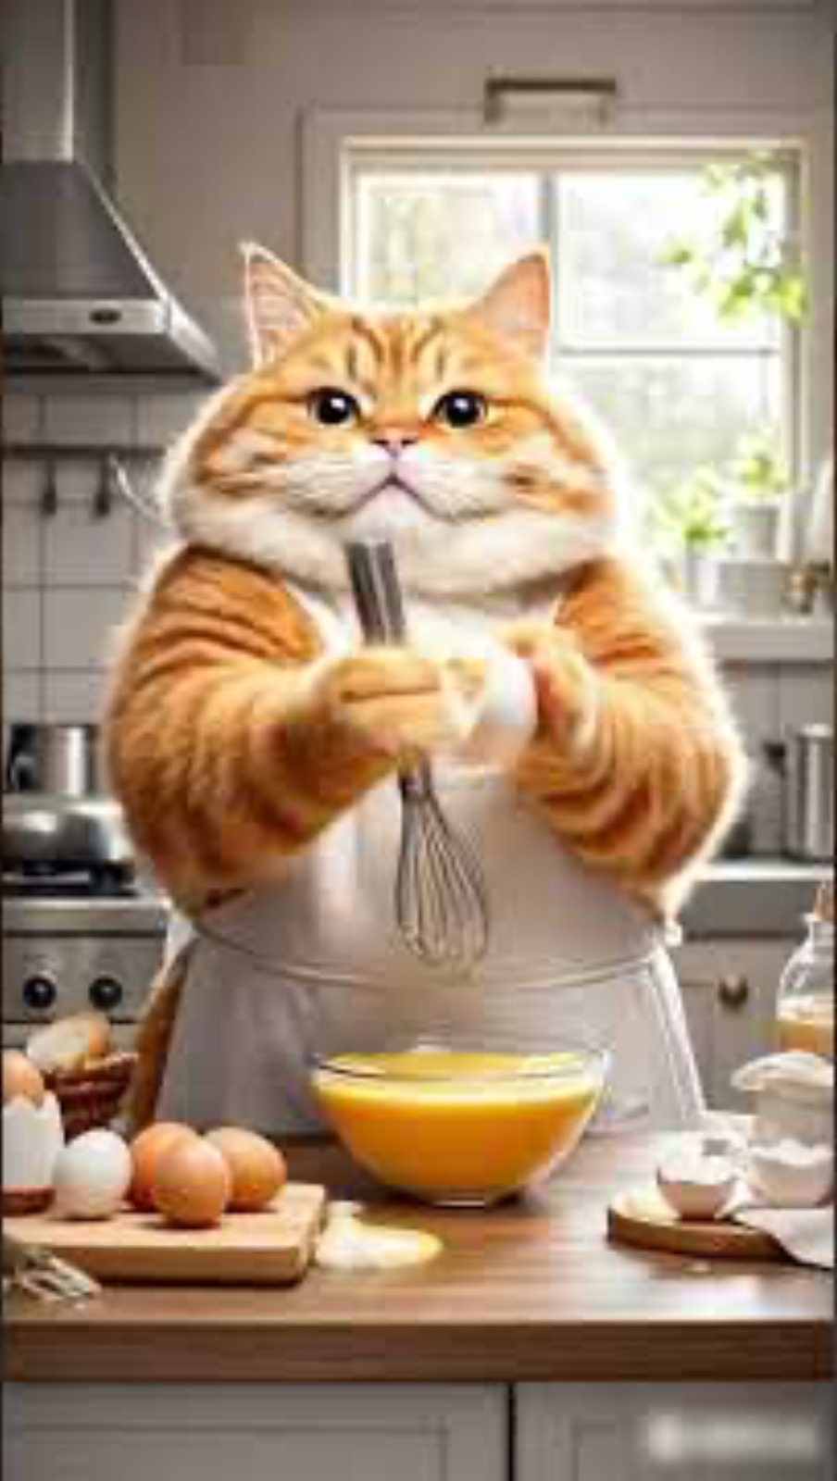

Example AI Stories
Here are some fun AI-generated stories to give you ideas
Here are examples of short AI-generated stories you can create using images, animation, and narration. These examples show what you can create by the end of the workshop.
“Scrambled Eggs with Tomatoes” An AI-generated short story video
Coca-Cola “Holidays Are Coming” An AI-generated ad-style video
Notes:
Hi everyone! Welcome to the workshop.
Today we’re going to explore how AI can help you create your own short story — with images, voices, music, and animation.
Here are two examples of AI-generated videos. These are the kind of short stories you can create too — fun characters, cool scenes, and animation driven by AI tools.

Slide 4
What You Will Create at the End of the Workshop
Your Final Project: A 1-2 Minute AI-Powered Story
🖼️ AI Images Create your own characters, scenes, and settings.
🎬 AI Video Animation Bring your images to life with simple animations.
🎤 AI Voice Acting Generate narration and character dialogue for your story.
🎵 AI Music & Sound Effects Add background music and mood-setting sound.
📱 Presentation & Editing Tools Combine everything into your final story video or slideshow.
You’ll leave with a complete mini-movie or illustrated story — fully created with AI.
Notes:
Now let’s take a look at what you will be able to create by the end of this workshop.
Your final project will be a one- to two-minute AI-powered story. You’ll get to choose your own characters, your own scenes, and your own style — funny, serious, sci-fi, fantasy… anything you want.
To build your story, we’re going to learn a few different AI tools.
First, you’ll learn how to create AI images.
These can be characters, settings, or objects in your story. You don’t need drawing skills — the AI will help you generate everything.
Next, you’ll learn how to turn those images into short animations.
This will help bring your scenes to life.
Then, we’ll use AI to create voices for your characters.
You can generate narration, dialogue, or even different voice styles.
After that, we’ll add music and sound effects.
This makes your story feel complete and more fun to watch.
Finally, you’ll learn how to put everything together
— images, animation, voice, and music — into a short video or slideshow that you can share at the end.
By the last session, you’ll have your own mini-movie or illustrated story, fully created with AI. You don’t need any experience — we’ll go step-by-step, and you’ll get to be as creative as you want.”

Slide 5
Story Ideas to Choose From
Don’t overthink it — pick something fun
Here are some story themes you can explore — or use them as inspiration for your own idea.
🚀 Sci-Fi & Adventure A Day in the Life of My AI Helper Space Adventure with an AI Friend The Future Gardener The Time-Traveler’s Pet | 🤣 Comedy The Animal Astronauts The Fridge Rebellion The Quest for the Perfect Pizza
✨ Fantasy & Mystery The Cloud Shepherd The Secret of the Night Library Fantasy Quest with AI Magic The Haunted Phone | 💗 Slice of Life AI Helps Me at School A Day in My AI-Powered Home My AI Friend’s Birthday Surprise
Notes:
Now that you’ve seen a couple of AI videos and you know what we’ll create in this workshop, let’s look at some story ideas.
You do not need to choose one right now. This slide is just to help you start thinking and to give you some inspiration.
We have four different categories here. Let me walk through them quickly.
Sci-Fi and Adventure
These are stories about robots, AI helpers, space, time travel — anything futuristic or exciting. For example, an AI pet that travels through time, or an AI friend who helps you explore another planet.
Fantasy and Mystery
These are more magical or mysterious stories — things like talking books, enchanted clouds, or strange messages from old devices. These stories let you be creative and imagine new worlds.
Comedy
These are fun and silly stories — like animals in space, smart appliances going on strike, or an AI chef that keeps messing up a recipe. If you like humor, this is a great category.
Slice of Life
These are everyday stories with a small twist — like AI helping you at school, or what life might be like with an AI friend at home.
Again, you don’t have to choose today. Just look at these ideas and see which ones feel interesting to you. As we learn more tools in the next sessions, you’ll naturally figure out what kind of story you want to create.

Slide 6
What is AI

Slide 7
Warm-Up: "Al or Human?"
A poem
Let's test your skills!
Can you tell what was made by Artificial Intelligence and what was made by a human?
A Poem:
After we read it, I’ll ask you to guess: was it written by a human or by AI?
Fog covered the oak tree like a white blanket. The night was calm and still. No birds sang, no wind blew — Just tiny drops of water falling on the grass.
Notes:
Okay, let’s start with a quick warm-up. I’m going to show you a short poem. After we read it, I want you to guess: Do you think a human wrote it, or AI wrote it? Don’t overthink it — just take your best guess.”
AI wrote this because the language is very smooth and general. It doesn’t show personal feelings or a unique style — which is typical for AI writing.
Ref: AI Dector Tool: https://gptzero.me/ Typical Prompt: "Write a short, four-line rhyming poem about fog at night in the woods."

Slide 8
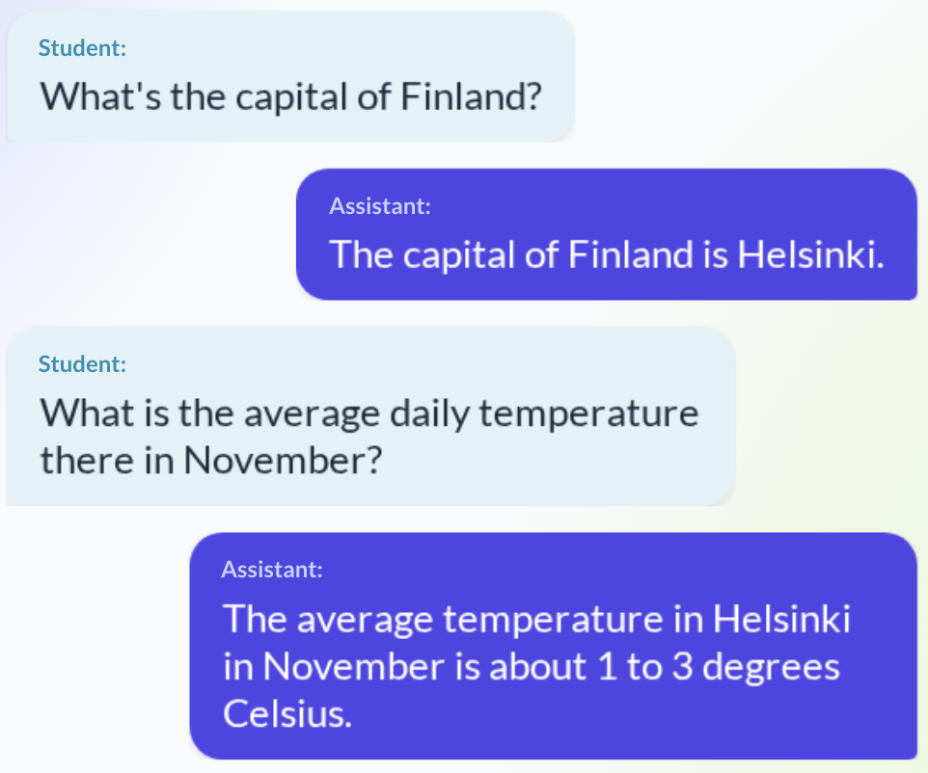
Warm-Up: "Al or Human?"
A poem
This is a conversation between a student and an assistant:
Let's test your skills!
Can you tell what was made by Artificial Intelligence and what was made by a human?
A Poem
A Conversation:
Was the Assistant a human or an AI? How did it know the *context*?
Notes:
The assistant was an AI.
It knew the context because AI models remember the earlier parts of the conversation while you’re still chatting. So when the student said ‘there’ in the second question, the AI remembered that ‘there’ referred to Helsinki from the first question.
AI doesn’t ‘understand’ like humans do, but it recognizes patterns and keeps track of the conversation text.”

Slide 9

Warm-Up: "Al or Human?"
A poem
Let's test your skills!
Can you tell what was made by Artificial Intelligence and what was made by a human?
A Poem
A Conversation
A Photo
Was the image made by an AI or a human artist?
What clues make you sure?
Notes:
You might think this is a painting or a very professional photo, but it was actually made by AI.
There are a few clues. The flowers are arranged in a way that’s almost too perfect. The lighting is very smooth and doesn’t have natural imperfections. Some of the textures look a little too clean or slightly plastic. And if you look closely, a few details don’t follow real physics.
These small clues tell us this is AI-generated.

Slide 10
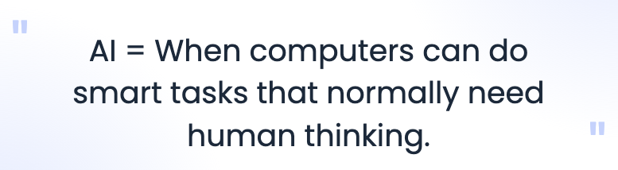
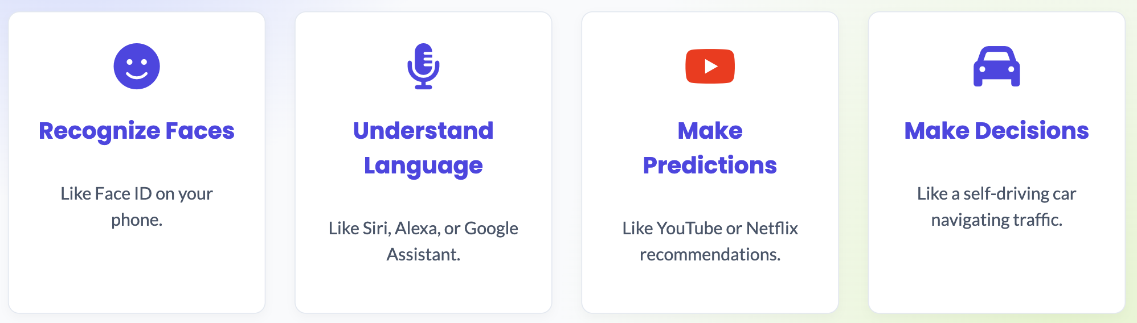
What is Artificial Intelligence?
https://www.youtube.com/shorts/SMC2lylFXeQ
Notes:
“So now let’s take a step back and answer a big question — what exactly is Artificial Intelligence?
Here’s the simplest way to think about it:”
“AI is when computers can do smart tasks that normally need human thinking.”
“In other words, if a computer can do something that usually requires a brain — noticing a face, understanding language, spotting patterns, or making a good decision — that’s AI!”
🧠 Examples:
😊 Recognize Faces
“Your phone uses AI to recognize your face when you unlock it — that’s AI noticing patterns in your eyes, nose, and face shape.”
🎤 Understand Language
“Voice assistants like Siri, Alexa, or Google Assistant understand what you say and talk back. That’s AI learning how humans speak.”
▶️ Make Predictions
“YouTube or Netflix recommending videos? That’s AI guessing what you might like based on patterns.”
🚗 Make Decisions
“Self-driving cars use AI to decide how to steer, when to brake, and how to avoid obstacles.”
🎥 Optional Cue
“Let’s watch a quick video that explains AI in a fun way.”

Slide 11
Everyday AI: 🏫 At Home
AI already lives in your home — here are places you probably use it every day:
📱 Smartphones — Face recognition, voice assistants (Siri, Alexa) 📺 Streaming Services — Netflix, YouTube recommendations 🎮 Gaming — Smart characters and adaptive difficulty 🎧 Music Apps — Personalized playlists (Spotify, Apple Music) 📸 Phone Cameras — Portrait mode, night mode, auto-enhancement 🌡️ Smart Thermostats — Learning schedules, optimizing temperature 🤖 Robotic Vacuums — Mapping rooms, recognizing objects 📷 Security Cameras — Detecting people vs. pets or wind 📱 Social Media — Filters, auto-captions, “For You” feeds
What else do YOU use at home that has AI?
Notes:
You might not realize it, but AI is already in a lot of things you use every day. Here are some examples — and after we go through these, I want to hear yours. Think about anything you use at home that recommends things, recognizes faces, filters photos, or automatically adjusts to what you like.”
"Show Your AI" Activity:
"Everyone hold up your phone. How many of these AI features are running right now?”
Go through the list with quick votes/actions:
Smartphones: "Who has Face ID or uses Siri/Alexa? Raise your hand!"
Streaming Services: "Who saw a YouTube or Netflix recommendation today? Nod your head!"
Gaming: "Who plays a game where the enemies or teammates act smart? Shout out the game name!"

Slide 12
Everyday AI: 🏫 At School
📘 Learning Apps — Personalized study plans 📝 Writing Tools — Grammar, spell check, rewriting help 🔍 Search Engines — Google and Bing finding answers 📚 Classroom Platforms — Google Classroom auto-organization 🤓 Study Tools — Quizlet AI, Photomath, Khan Academy 🗣️ Language Learning — Duolingo AI practice 🧑‍💻 Accessibility Tools — Live captions, text-to-speech 🌐 School Filters — AI detecting unsafe or inappropriate content
What else do YOU use at school that has AI?
Notes:
AI isn’t just at home — it’s also everywhere at school.
Some tools help you write or study. Some help you learn languages. Some help teachers organize work. And even the school Wi-Fi uses AI to keep everyone safe.
What else can you think of that uses AI at school?

Slide 13
Everyday AI: 🚗 In the World
🗺️ Navigation — Google Maps predicting traffic 📸 Photo Apps — Snapchat filters, Instagram effects 🛒 Online Shopping — Product recommendations 🚗 Cars — Lane assist, parking assist, auto-braking 🎵 Music Apps — Spotify suggestions, TikTok feeds 🏥 Health Tracking — Apple Watch, Fitbit analyzing activity 💬 Chatbots — Customer support on many websites 💳 Payments — Fraud detection, FaceID/TouchID
What else do YOU use outside your home that uses AI?
Notes:
AI isn’t just at home or at school — it’s everywhere in the world.
When you travel, shop, drive in a car, get music suggestions, or even use a smartwatch, AI is helping behind the scenes.
What other everyday tools do you think are using AI?

Slide 14
How Does AI Actually Learn

Slide 15
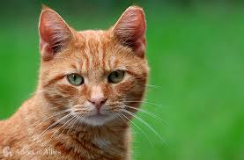
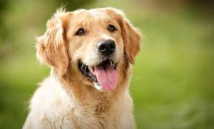

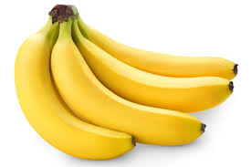
What is Machine Learning
Learn from Patterns
Your brain knows this because you’ve seen thousands of cats, dogs, bananas in your life.
AI learns the same way — learn from patterns - by looking at lots of examples.
Notes:
AI is like teaching computers to think and make decisions—almost like giving them a brain.
But instead of learning from a teacher, they learn from data.
Imagine teaching a baby what a cat is.
You show the baby many pictures of cats.
The baby slowly learns the patterns: pointy ears, whiskers, tail.”
“Machine learning is the same.
We show the computer thousands of pictures, and it learns the patterns.

Slide 16
What is Machine Learning
Learn from Patterns
Machine Learning = computers learning patterns from examples.
Positive or Negative (Sentiment)
“This game is awesome!” 🎮
“This movie is boring.” 🎬
“I hate homework.” 😒
“I’m excited for Friday!” 🎉
This is exactly what ML does — analyzing text by patterns.
Notes:
Now let’s talk about what machine learning really means. Machine learning is when a computer learns patterns from examples.
For example, look at these sentences. Some feel positive, and some feel negative. A human can tell right away. And machine learning can too — because it learns the patterns in how we write.
So if we give the computer enough examples of positive and negative sentences, it learns to tell the difference on its own.”

Slide 17
What is Machine Learning
Training
Imagine a robot trying to shoot a basketball🏀 for the first time.
It tries. It fails. It tries again.
Each time it adjusts a little bit.
That adjusting process is machine learning.
🔁 Try → Fail → Improve.
🔁 Try → Fail → Improve.
Hands-On Demo
🗑️ Throw a crumpled paper ball into a trash bin from 10 feet away.
Notes:
Machine learning is like teaching a robot how to shoot a basketball. At first, it’s terrible — it misses every time. But each time it misses, it learns just a tiny bit. It fixes its angle or its strength. Try, fail, improve… try, fail, improve.
AI models learn the same way. They make small mistakes millions of times and slowly get better.
Now we’re going to try the same idea ourselves — take a piece of paper, crumble it into a ball, and throw it into the trash bin from 10 feet away. You’ll miss, and then you’ll adjust. That’s machine learning.

Slide 18
What is Machine Learning
Learns from data, not rules
🍳 If you cook a dish for the first time, maybe it’s too salty.
Next time you add less salt. Then you improve until it tastes good.
Machine learning works like that — adjusting little by little until the result is good.
🤳 It’s like giving the computer 1,000 selfies.
After seeing so many, it learns what a face looks like — without anyone manually programming it.
https://www.youtube.com/watch?v=DaxGIuO-_C0
Notes:
Machine learning is all about learning from examples, not rules.
For example, imagine you cook a dish for the first time. Maybe it’s too salty. Next time, you add less salt. You adjust. Then you adjust again until it tastes right.
Machine learning works the same way. It improves step by step.
Another example is selfies. If you give a computer a thousand selfies, it starts to learn what a face looks like. It isn’t because someone programmed every detail — it’s because it saw so many examples.
So the big idea is: machine learning learns by looking at lots of data and adjusting little by little.”

Slide 19
What is Machine Learning
Demo: “AI Guessing Game: Can the AI recognize your object?”
Teachable Machine (Google)
https://teachablemachine.withgoogle.com/
HuggingFace image classification demo (Dog or Cat)
https://huggingface.co/spaces/shubhamthakur-2504/ImageClassification
The AI learned by looking at millions of photos — that’s machine learning.
Notes:
Alright, now we’re going to try something fun — an AI guessing game.
These are three websites where you can show an image or object to an AI, and it will try to guess what it is.
The first one is Google’s Teachable Machine. This one lets you train your own mini-AI by giving it examples. It’s super simple and very cool.
The second one is a HuggingFace demo. You upload a picture of a dog or cat, and the AI will guess which one it is.
And the third one is a ResNet demo, which shows how a real image-recognition model sees pictures through layers.
All these AIs learned the same way — by looking at millions of photos. The more examples they see, the better they get.
In a moment, I’ll let you pick an object — a phone, a shoe, even your water bottle — and we’ll see if the AI can recognize it!”

Slide 20
Key Takeaways
Machine learning means the computer learns from examples.
Just like we learn by looking, trying, and failing, the computer learns by seeing lots of data.
If we show it thousands of pictures of cats and dogs, it learns the patterns and can tell them apart.
Notes:
Alright everyone, before we wrap up this section, here are the big ideas I want you to remember about machine learning.
👉 First, machine learning means the computer learns from examples, not from step-by-step instructions. We don’t manually tell the computer: ‘This is how you recognize a cat.’ Instead, we give it lots and lots of examples, and it figures out the patterns on its own.
👉 Second, this is similar to how we learn things. Think about how you learned to ride a bike, or play basketball, or draw. You didn’t read a giant rulebook — you learned by trying, failing, adjusting, and trying again.
👉 Third, the same happens with computers. If we show it thousands of pictures of cats and thousands of pictures of dogs, the computer starts to notice patterns that we don’t even think about — like tiny texture differences or shapes.
👉 Eventually, the computer becomes really good at telling them apart, even when we would struggle.

Slide 21
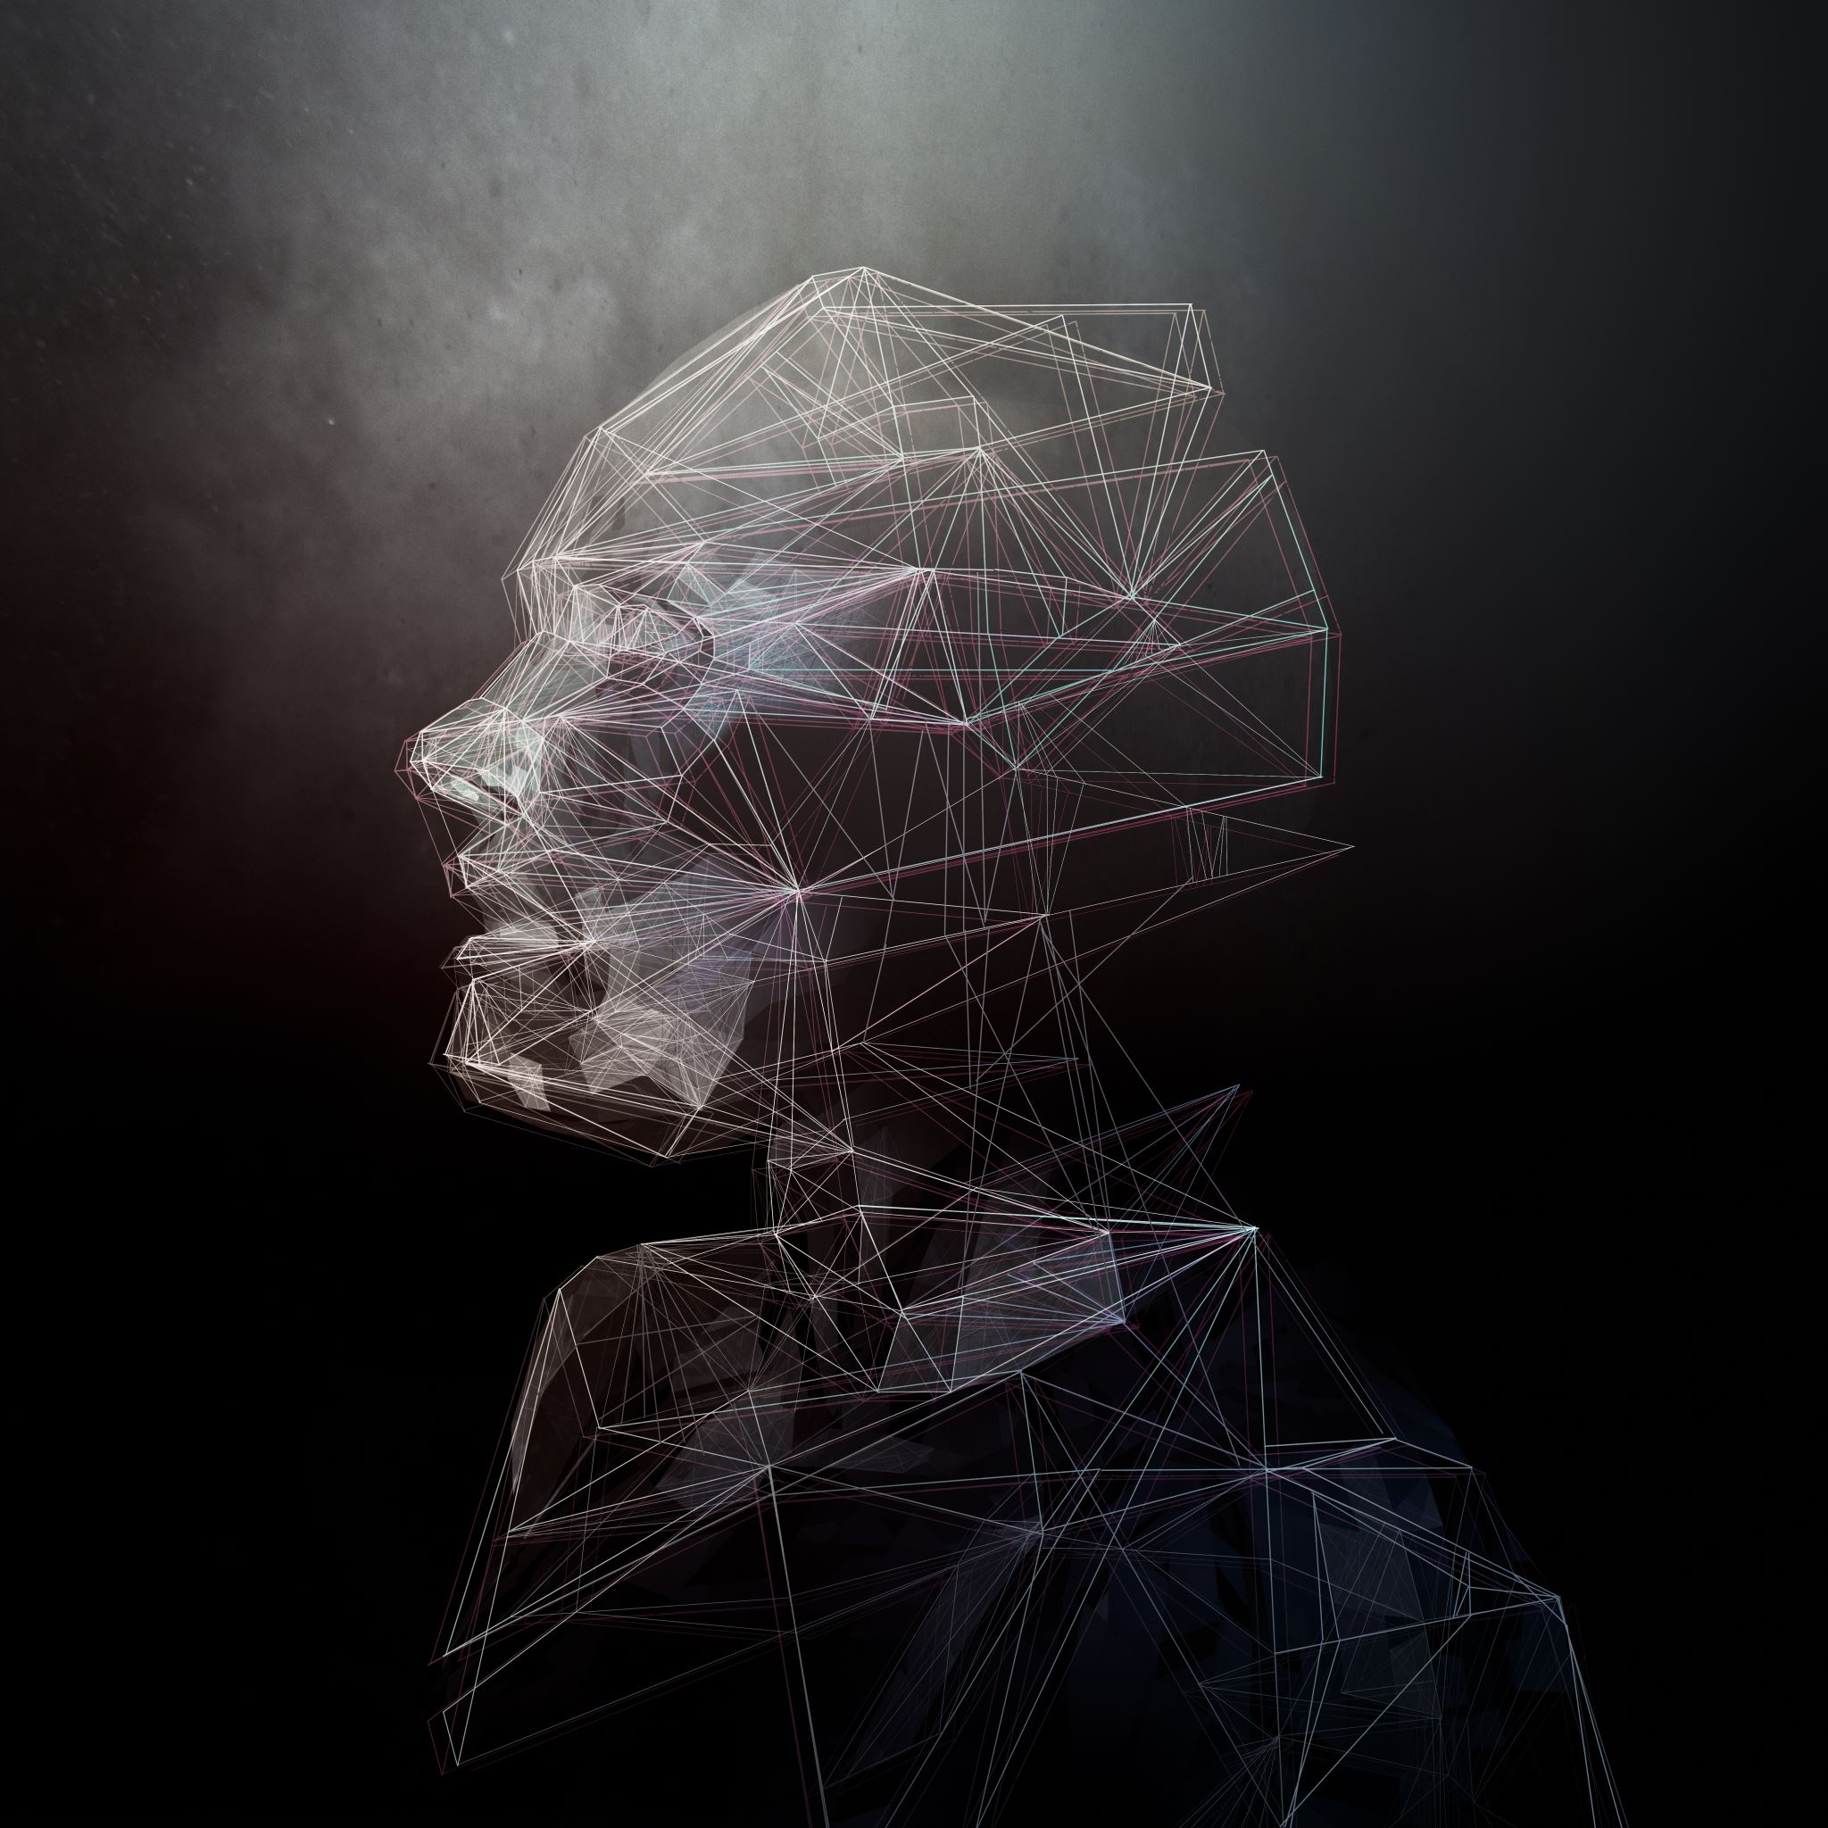
How does AI Recognize Faces
Neural Network
Notes:
Now we’re going to look at something really cool — how AI recognizes faces.
You’ve all seen this before: Your phone unlocks when it sees your face. Snapchat filters stick perfectly to your eyes and mouth. But how does the AI actually know it’s you?

Slide 22
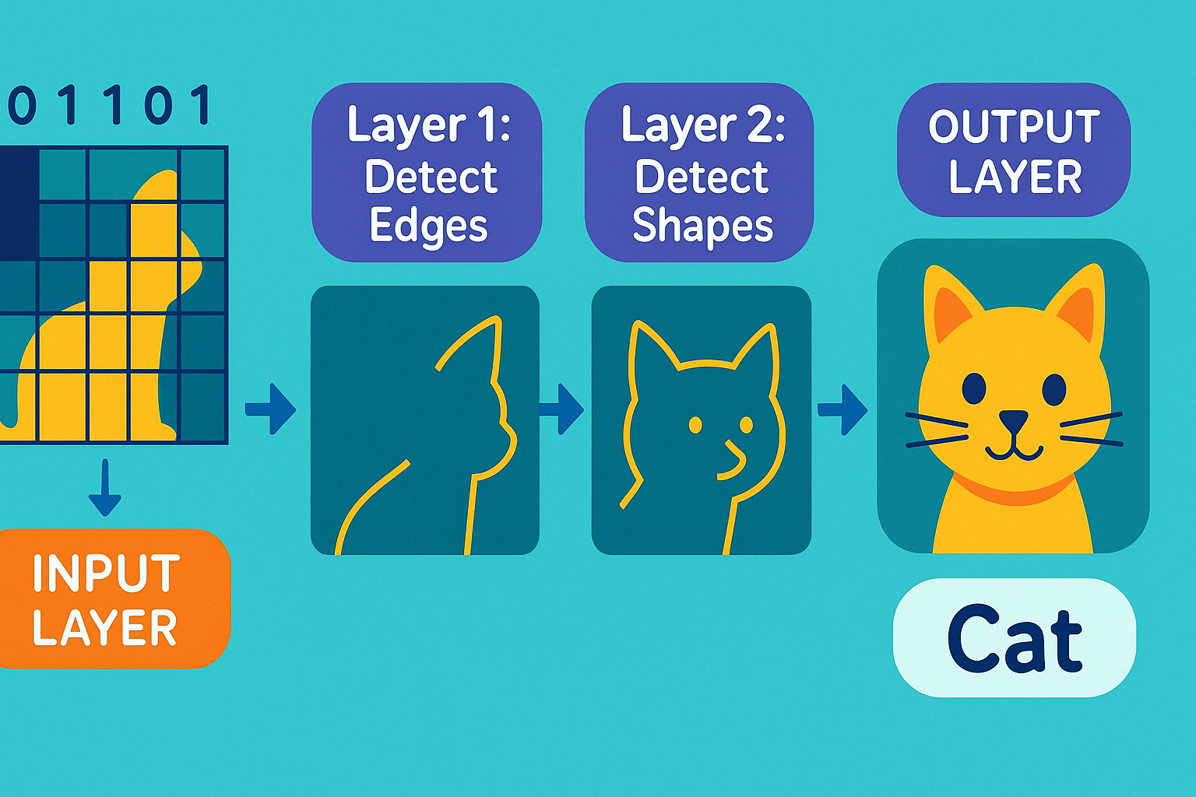
How Does AI Recognize Faces
Neural Network
Face recognition uses something called a Neural Network.
A neural network is like a stack of smart filters.
The first layer finds simple patterns like lines or edges.
The next layer finds shapes, like circles or curves.
The later layers find features, like eyes, nose, or mouth.
Then the AI asks:
“Is this Garry’s face? Yes or no?”
Step by step, the AI builds up understanding.
Online ResNet Demo:
https://tensorspace.org/html/playground/resnet50.html
Notes:
Alright, now let’s look at how AI recognizes faces — and it’s actually much simpler than it sounds.
Face recognition uses something called a neural network. A neural network is basically a stack of really smart filters.
Here’s how it works:
The first layer looks for very simple patterns — things like straight lines or edges.
The next layer starts spotting shapes, like circles or curves.
Deeper layers find features, like eyes, noses, or mouths.
And finally, the AI combines everything and basically asks: ‘Is this Garry’s face? Yes or no?’
So the AI doesn’t magically know faces — it learns them step-by-step, building understanding from tiny details to full features.”

Slide 23
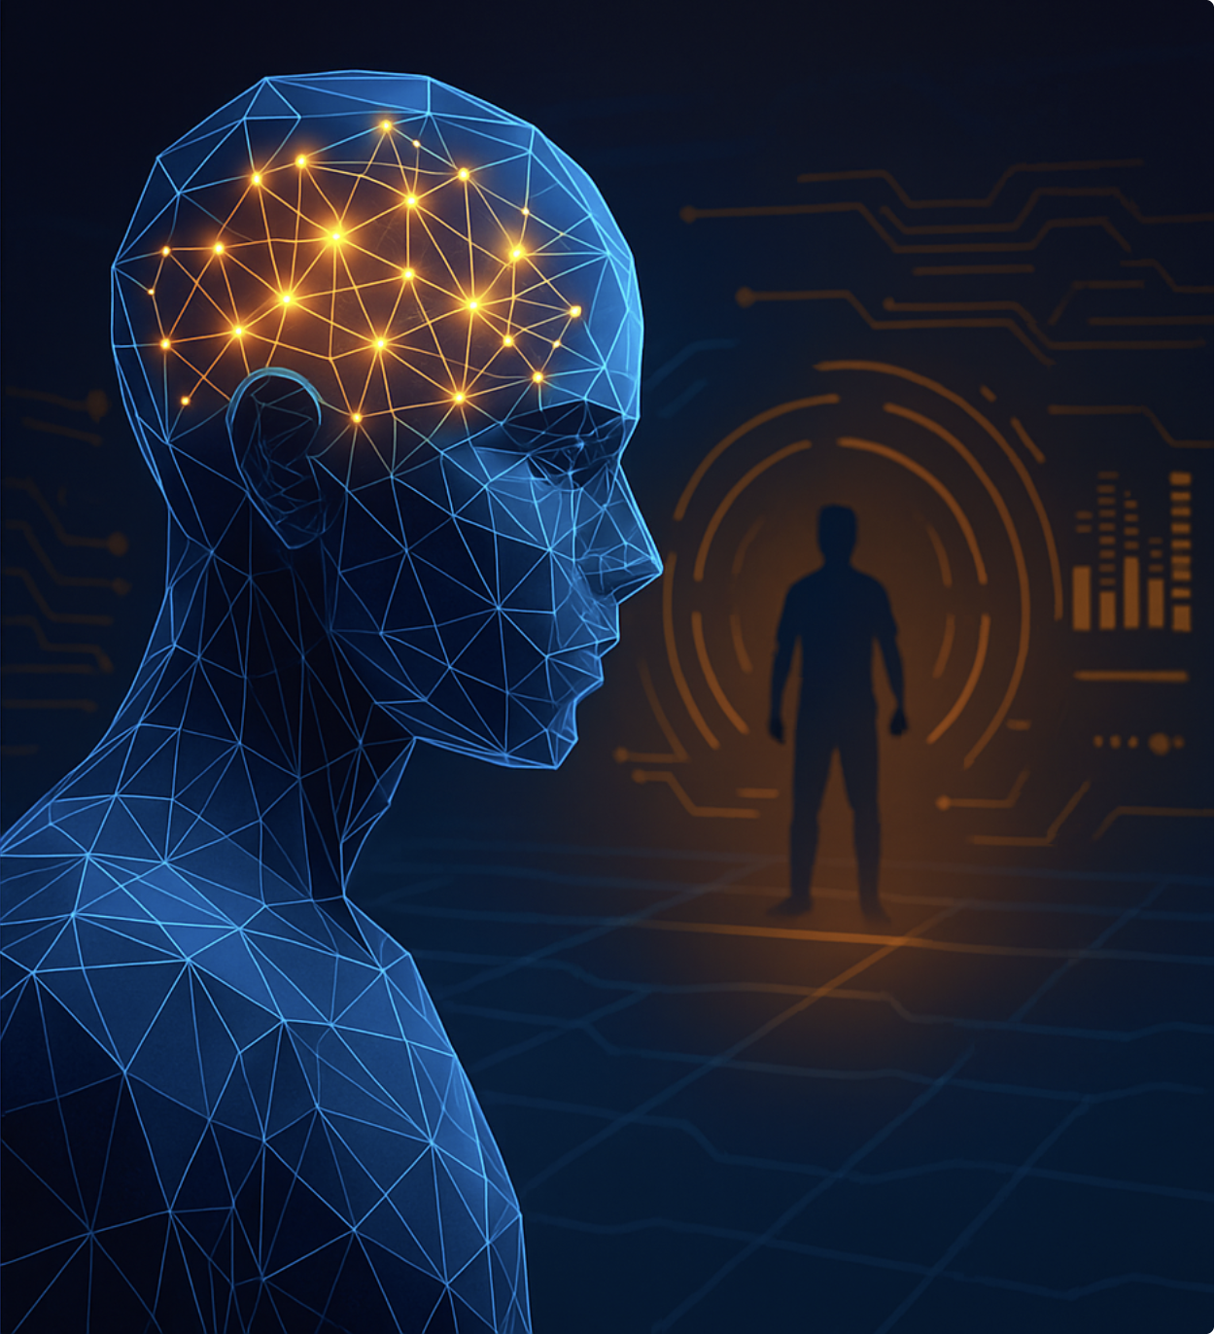
Gaming — Smart Characters That Play Against You
How games use AI to make enemies learn, adapt, and challenge you.
Notes:
Now let’s talk about AI in games — because this is one of the coolest places where AI shows up in your everyday life.
When you play a game — Minecraft, Fortnite, Roblox, Zelda — the enemies feel smart, right? They chase you, hide, attack, or run away.
But here’s the secret… They’re not actually smart. They don’t think. They don’t have feelings.
They follow RULES — and those rules are controlled by Game AI.

Slide 24
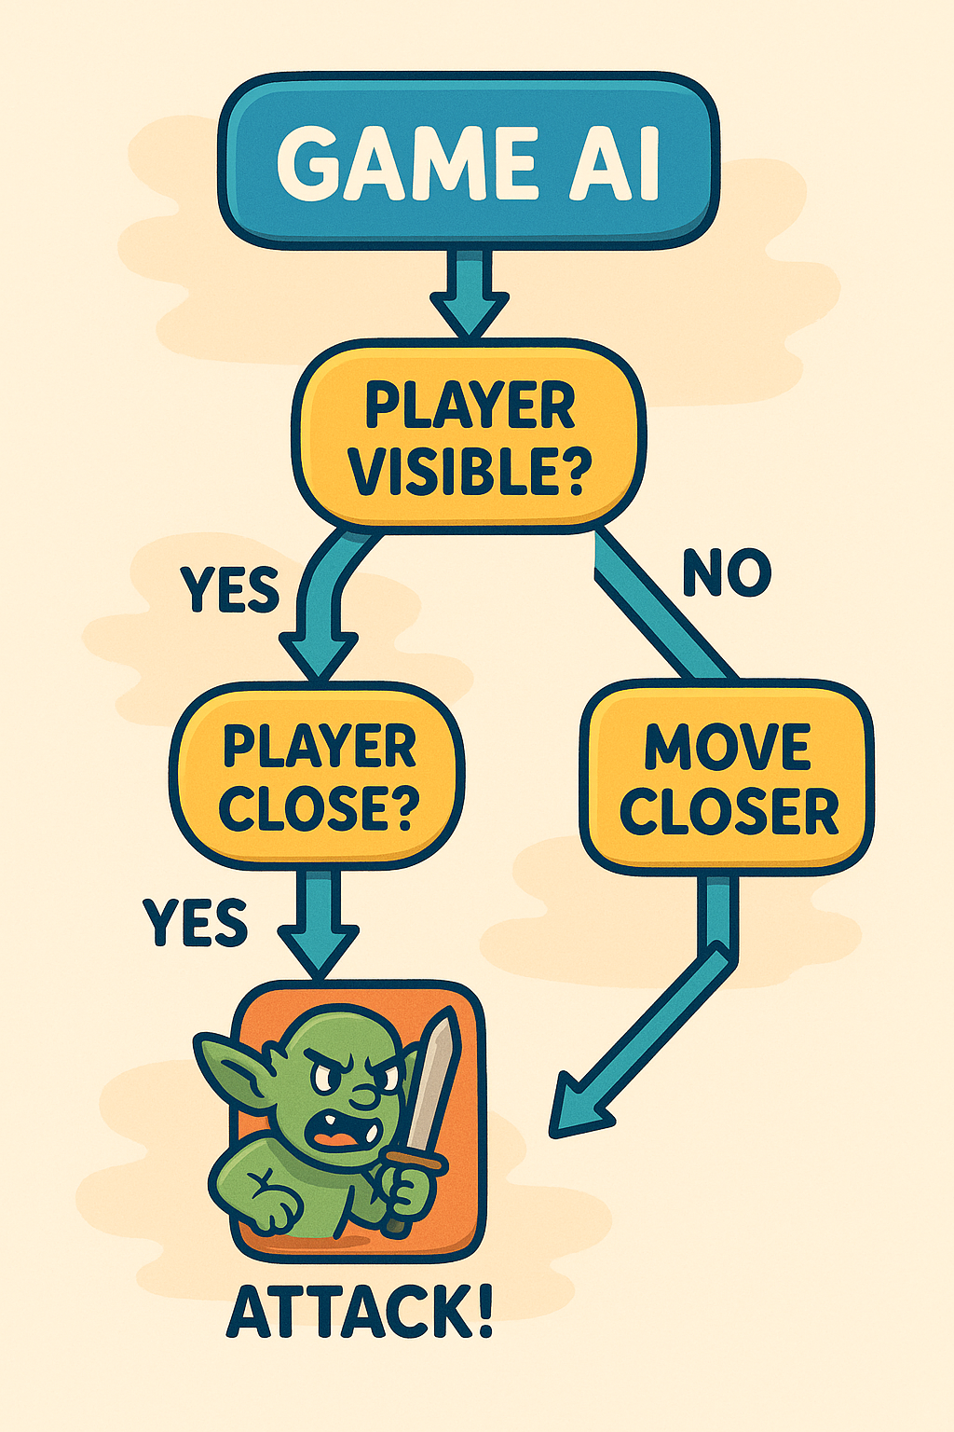
Game AI
Decide what to do next using something called a Decision Tree
Game AI makes characters act smart.
They decide what to do next using something called a Decision Tree — like a flowchart.
🎮 Minecraft mobs
See player?
Yes → Is player close?
Yes → Attack
No → Walk toward player
No → Wander around
Notes:
*Game AI uses something called a Decision Tree. Think of it like a Choose-Your-Own-Adventure book or a flowchart.
The game checks:
‘Do I see the player?’
‘Is the player close?’
‘Should I attack?’
And the character simply follows the path.
So here’s an example: If the player is visible → check if the player is close. If close → ATTACK. If not close → walk toward them.”
This is EXACTLY how Minecraft mobs decide what to do.

Slide 25
Game AI
Demo: “You Are the Game AI”
4 cards:
PLAYER VISIBLE
PLAYER NOT VISIBLE
PLAYER CLOSE
PLAYER FAR
The “AI Enemy” must follow the Decision Tree:
If not visible → Patrol
If visible and far → Walk closer
If visible and close → Attack (pretend)
Notes:
So now… YOU are going to become the Game AI. You’re going to follow a decision tree — just like a video-game enemy does.”
“I’ll show you 4 cards, one at a time:
PLAYER VISIBLE
PLAYER NOT VISIBLE
PLAYER CLOSE
PLAYER FAR
And your job is to respond ONLY using the AI’s rules.

Slide 26
Try It Yourself: ChatGPT
Notes:
Alright everyone — now it’s your turn! We’ve talked about AI, machine learning, face recognition, and game AI… But now we’re going to try something you can use right now — ChatGPT.”

Slide 27
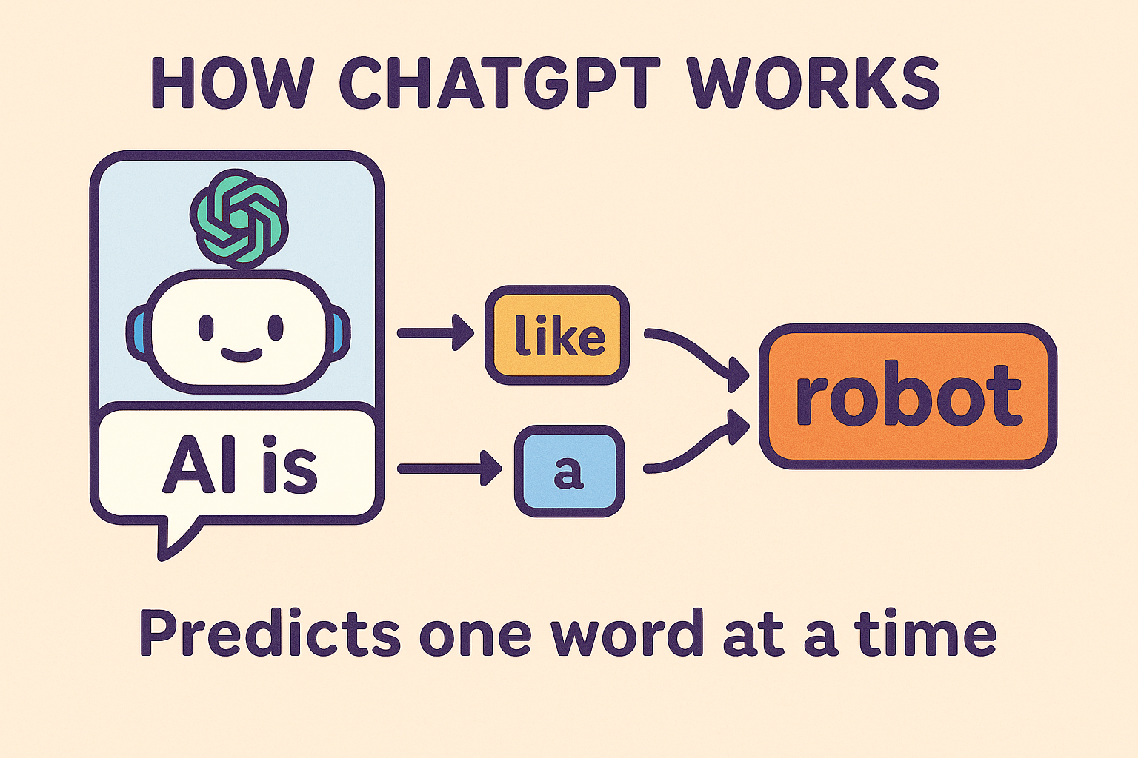
What is ChatGPT
ChatGPT is an AI that learned from a huge amount of text - books, websites, conversations
It uses a Large Language Model, or LLM
When you type something, it guesses the next word, then the next word, building a full answer.
AI builds a sentence one word at a time. It picks the best next word based on everything it has learned.
Like Building a Burger-> one ingredient at a time
Like autocomplete, but supercharged
Notes:
ChatGPT is like a super-smart buddy who has read almost everything online — books, articles, websites, stories. But it’s not magic. It doesn’t ‘think’ like humans do. It predicts one word at a time, like supercharged autocomplete.”

Slide 28
Try It Yourself: ChatGPT
Safety & Behavior Guidance
ChatGPT is smart but not perfect.
It can make mistakes, and sometimes it sounds confident even if it’s wrong.”
Never share your real name, address, school, or personal info.
If you see something weird or confusing, ask your instructor.
Notes:
Before we try it, remember: ChatGPT is helpful, but it’s NOT perfect. It can make mistakes, and you should never share personal info — like your full name, address, school name, or anything private.

Slide 29
Try It Yourself: ChatGPT
What should we ask the AI first? Something fun or silly?
“Tell me a fun fact about space.”
“What superpower should I have and why?”
“Explain AI using only emojis.”
“Write a poem about a robot who wants pizza.”
“Would cats or dogs make better astronauts?”
“Make a riddle for me to solve.”
“Give me a story that ends with a twist.”
It’s like having a super-smart friend who has read almost everything online.
Try ChatGPT
Ask one fun question
Ask one serious question
Ask one creative challenge
Notes:
We’re going to experiment with ChatGPT together. First, I’ll show you how it works. Then you’ll try asking it questions — fun questions, serious questions, and creative challenges.
You can ask ChatGPT almost anything: – a poem – a joke – a story – homework help – game ideas – or even explain something using emojis.

Slide 30
Try It Yourself: ChatGPT
Bonus: Prompt Engineering
A super simple rule:
“If you want better answers, ask better questions.”
Example:
OK: “Explain dinosaurs.”
Better: “Explain dinosaurs to a 5-year-old using emojis.”
Notes:
“Alright everyone, now that you’ve tried ChatGPT a little bit, I want to show you a really cool trick…
👉 How to get BETTER answers from AI — just by asking better questions.
This idea is called Prompt Engineering, but don’t worry — that’s just a fancy phrase that means:
‘If you want better answers… ask better questions.’
Super simple, right?
Let me show you what that looks like.
If you ask ChatGPT:
‘Explain dinosaurs.’ …it will give you a basic explanation.
But if you get more specific or more creative:
‘Explain dinosaurs to a 5-year-old using emojis.’ Now the AI understands who the explanation is for, how simple it should be, and what format you want.
The answer becomes way better and way more fun.
So the trick is:
🧠 Tell the AI what you want 🧩 Tell it how you want it 🎯 Tell it who it’s for
This works for everything — stories, homework help, jokes, explanations, anything.

Slide 31
Try It Yourself: ChatGPT
More Challenges
Make a list
Explain something simple
Explain something complex
Dream Vacation Planner
"Plan a perfect day for me at [your dream destination]. Include activities, food, and fun things to do!”
Creative Writing with AI
Ask ChatGPT to help you write:
- A short story about a robot friend
- A poem about your favorite hobby
- A funny joke
- An adventure story
Notes:
Awesome job, everyone! You’ve already asked ChatGPT fun questions, serious questions, and even tried a creative challenge.
Now we’re going to level up.
This next part is called ‘More Challenges’ — and it’s designed to show you how much ChatGPT can help with all kinds of tasks, from simple things to really creative projects.
I’m going to walk you through a few ideas, and then you’ll get to pick any challenge you like and try it yourself.
First, you can try something simple like making a list. Then, something a bit harder — like asking ChatGPT to explain a topic. Or, if you want to go big, you can try a full creative challenge.
One fun option is the Dream Vacation Planner — ChatGPT can design your perfect day anywhere in the world. And for those of you who like stories or writing, there’s the Creative Writing challenge — ChatGPT can help you write a short story, a poem, a joke, or even an adventure.
Choose one that feels fun for you. Remember: there’s no ‘wrong’ answer. This is your time to explore what AI can do.”

Slide 32
AI Translation & Language Understanding
How AI understands meaning, context, and different languages
Notes:
Awesome job trying out ChatGPT, everyone! You’ve just seen how AI can write, create, and answer questions — but now we’re going to look at something even cooler:
How does AI understand language at all? And… how can it understand multiple languages?
Think about it: When you say the same sentence in English, Chinese, Spanish, or Korean — you still mean the same thing. But the words are totally different. AI has to figure out:
What do the words mean?
What is the context?
What is the emotion?
And how to say the same idea in another language?
This skill is called language understanding, and it’s the secret sauce behind ChatGPT, Google Translate, subtitles, and even voice assistants like Siri.
So in this next section, we’re going to explore:
How AI knows what words really mean
How it connects meaning across different languages
And why AI translations today are much smarter than the old Google Translate from 10 years ago
Let’s jump into it.

Slide 33
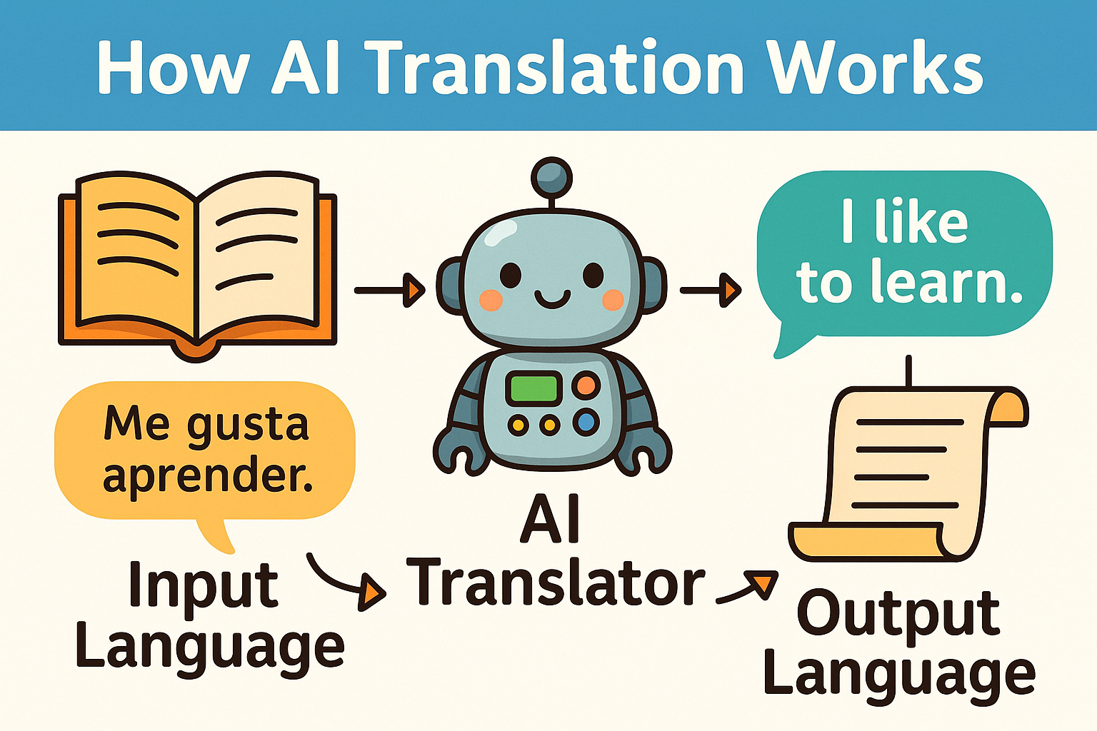
How AI Translation Works
AI translation works because the model has learned from huge amounts of text in many languages – Books, Websites, Articles, Conversations, etc.
It learns how words, grammar, and patterns match across languages.
Translation is about converting meaning, not swapping words — it’s trying to understand the meaning, then express that meaning in another language.
Notes:
Now let’s talk about how AI does translation — like Google Translate.
AI has read a huge amount of text in many languages: books, websites, conversations, everything. From all that reading, it learns patterns — how words and grammar work in different languages.
The key idea is this: AI doesn’t just swap words. It tries to understand the meaning first.
So if it sees a sentence in Spanish, like ‘Me gusta aprender,’ the AI understands the idea, and then re-expresses that idea in English as ‘I like to learn.’
AI translation is basically understanding meaning → then rewriting it in another language.”

Slide 34
Try AI Translation
👉 Try DeepL Translator (https://www.deepl.com/translator)
Demo sentence : “AI is helping the world learn faster.”
Write 2-3 sentences about AI in English
A joke
A poem
A tongue twister
A short story
2. Translate it to another language (Spanish, French, Japanese, etc.)
(Try translating into 2–3 different languages and compare.)
3. Translate it back to English
What stayed the same?
What changed?
Did the meaning stay correct?
Which translation changed the most?
Notes:
“Alright everyone, now we’re going to try AI translation ourselves — and this part is really fun.
First, open DeepL Translator — the link is right here on the slide.
To warm up, I’ll show you a demo sentence: ‘AI is helping the world learn faster.’ Watch how DeepL turns that into other languages.
Now it’s your turn.
Step 1 — Write 2–3 short sentences in English
You can choose anything you like:
A joke about AI
A tiny poem
A tongue twister
A super short story
Whatever you write — keep it fun!
Step 2 — Translate it into another language
Try Spanish, French, Japanese, Korean — whatever you want. In fact, try 2 or 3 different languages and compare how they look.
Step 3 — Translate it back to English
This is the interesting part. Ask yourself:
What stayed the same?
What changed?
Did the meaning stay correct?
Which translation changed the most?
This helps you understand how AI translation focuses on meaning, not just swapping words.
Okay — let’s begin! Everyone write your sentences.”

Slide 35
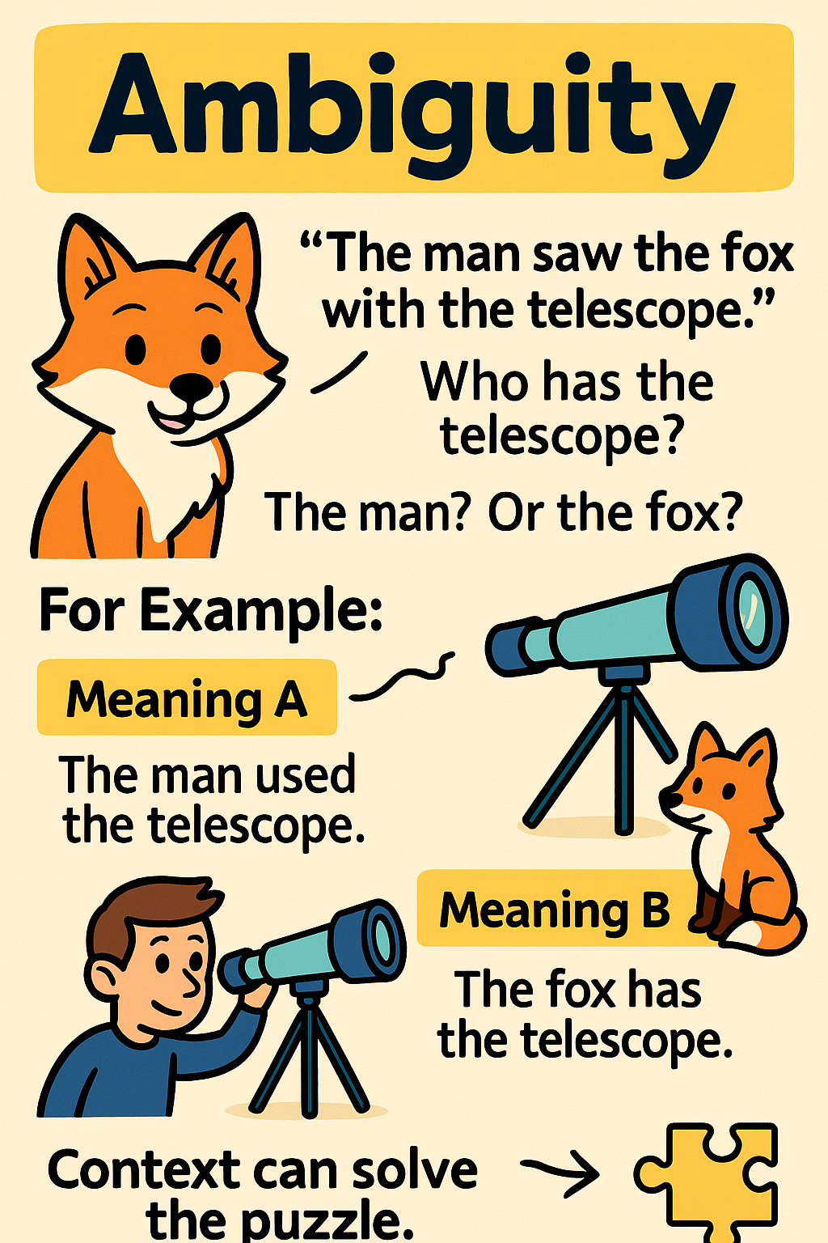
Try AI Translation
Context & Ambiguity Challenge
Language is tricky because many sentences can have more than one meaning.
Without clues, AI guesses.
With clues, AI becomes much smarter.
For example:
‘The man saw the fox with the telescope.’
Who has the telescope? The man? Or the fox?
Meaning A
The man used the telescope to see the fox.
📌 The man has the telescope.
Meaning B
The fox is holding the telescope.
📌 The fox has the telescope.
Translating this sentence forces the AI to choose one meaning.
Notes:
Alright everyone, here’s where AI translation gets a little tricky — and also very interesting.
Language is full of sentences that can mean more than one thing. Humans usually solve this easily because we use context. But AI? If we don’t give it clues, it has to guess.
Let’s look at this example sentence:
‘The man saw the fox with the telescope.’
Now… who has the telescope? Is it:
The man using a telescope to look at the fox?
Or the fox carrying a telescope?
There are actually two correct meanings:
Meaning A
➡️ The man used the telescope.
Meaning B
➡️ The fox has the telescope. (A very fancy fox!)
When AI translates this sentence into another language, it has to pick one of these meanings — it cannot keep the ambiguity. So translation forces the AI to make a decision.
This is why context is so important. When you give the AI extra clues, it becomes much smarter and chooses the meaning you intended.”

Slide 36
Try AI Translation
Context & Ambiguity Challenge - Adding Context
AI can guess better when it uses clues from context.
New context:
“The astronomer looked through his telescope. The man saw the fox with the telescope.”
“Astronomer” + “looked through his telescope”
A human using a telescope makes more sense than a fox.
The meaning becomes clearer
AI will now almost certainly choose Meaning A.
Notes:
Now let’s look at how adding context helps AI understand language better.
Earlier we had the confusing sentence: ‘The man saw the fox with the telescope.’ We didn’t know who had the telescope — the man or the fox.
Now look at the NEW version:
‘The astronomer looked through his telescope. The man saw the fox with the telescope.’
Because we added ‘astronomer’ and ‘looked through his telescope,’ the sentence suddenly makes more sense:
Astronomers usually use telescopes.
Foxes don’t normally hold telescopes.
So now the AI almost always chooses Meaning A — the man has the telescope.
This shows how important context clues are in language. With more information, AI makes much smarter guesses.

Slide 37
Try AI Translation
Context & Ambiguity Challenge – Write Your Own Sentences
Activity: Write Your Own Ambiguity Sentences
Invent sentences that have two meanings:
Examples:
“The chicken is ready to eat.”
“I saw her duck.”
“The teacher helped the student with the problem.”
“The old man the boat.”
Then translate them in DeepL or ChatGPT and see which meaning the AI chooses.
This is a big challenge in NLP (Natural Language Processing) - AI has to use patterns, clues, and statistics to guess the meaning. Sometimes it gets it right, sometimes wrong.
Notes:
Alright everyone, this is a fun challenge! Now that you understand how AI handles tricky and confusing sentences, it’s your turn to trick the AI.
Some sentences in English can have two different meanings, and humans understand them using context — but AI sometimes struggles.
Let’s look at a few examples:
‘The chicken is ready to eat.’ → Is the chicken hungry, or is the chicken prepared as food?
‘I saw her duck.’ → Did she own a duck, or did she lower her head?
‘The old man the boat.’ → Weird sentence, but it also has two meanings!
Your activity: 👉 Write your own ambiguous sentence — something that can be interpreted two different ways.
Once you have one, we’re going to copy it into DeepL or ChatGPT and see:
Which meaning did the AI pick?
Did it guess the same meaning you intended?
Did the translation change the meaning?
This exercise shows why ambiguity is one of the hardest problems in NLP, because AI has to use clues, grammar, and probability to guess the meaning — and sometimes it gets it right, sometimes… not so much.
Ready? Let’s create some confusing sentences!”

Slide 38
Reflection: Why Translation Is Hard for AI
Human language is full of ambiguity
Context changes meaning
Words can have multiple meanings
Some ideas don’t exist in other languages
AI uses patterns and statistics to guess
Sometimes it gets it wrong (just like humans!)
This is a big challenge in NLP (Natural Language Processing) - AI has to use patterns, clues, and statistics to guess the meaning. Sometimes it gets it right, sometimes wrong.
Notes:
“Alright everyone, before we finish this section, let’s take a moment to think about what we just learned.”
“Human language is tricky. It’s full of ambiguity — meaning many sentences can have more than one meaning depending on how you read them.”
“Also, context matters a LOT. The same sentence can mean one thing in one situation, and something totally different in another.”
“Words themselves can have multiple meanings — like bark, bat, spring, or duck. AI has to figure out which meaning you intended.”
“But there’s an even bigger problem: some ideas simply don’t exist in other languages. So AI has to try its best to express something even if that language doesn’t have the exact same concept.”
“AI doesn’t ‘understand’ language the way humans do — it uses patterns and statistics. It guesses the most likely meaning based on everything it has learned.”
“And… sometimes it gets it wrong. Just like people do!”
“This challenge is part of a field called NLP — Natural Language Processing. It’s one of the hardest problems in AI, because language is messy, flexible, creative, and full of exceptions.”
“So next time a translation looks funny, remember: even AI is still learning!”

Slide 39
Key Takeaways
AI translation focuses on meaning, not exact words
Context helps AI choose the correct meaning
Translation mistakes often come from ambiguity
Testing multiple languages helps expose meaning changes
AI understanding is powerful—but not perfect
You can test AI translation yourself to see how meaning changes!

Slide 40
Spot the Fake
An Introduction to AI Deepfakes
Learn how to outsmart AI fakes!
Notes:
Alright everyone — now that we’ve explored how AI understands language and meaning, let’s switch to something totally different… and a little more exciting.
We’re going to talk about AI deepfakes — fake images, videos, or audio created by AI that look super real. This section is called ‘Spot the Fake’ — and it’s all about learning how to outsmart AI fakes.
Why are we doing this? Because AI can create amazing, helpful things — but it can also create convincing fakes. And being able to tell what’s real and what’s not is becoming an important skill for everyone.
The good news? Once you know what clues to look for, spotting fakes becomes much easier — like a detective game.
So in this section, we’re going to:
Learn what deepfakes are
Understand how they’re made
See real examples
And most importantly… test your “fake-spotting” superpowers
Ready? Let’s dive into Spot the Fake and see if you can beat the AI!”

Slide 41
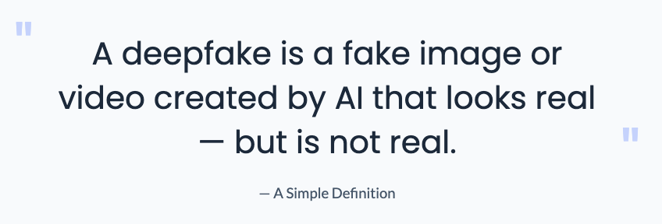
What is a Deepfake
Notes:
Alright everyone, before we start spotting fakes, let's make sure we know what a deepfake actually is.
A deepfake is a picture or a video that looks real, but was created by AI.
It might show a person doing something they never did, or saying something they never said.
Deepfakes can be funny—like putting your face on a superhero—but they can also be used to mislead people.
So today, we’re going to learn how to recognize them, so you can stay smart and safe online.”

Slide 42
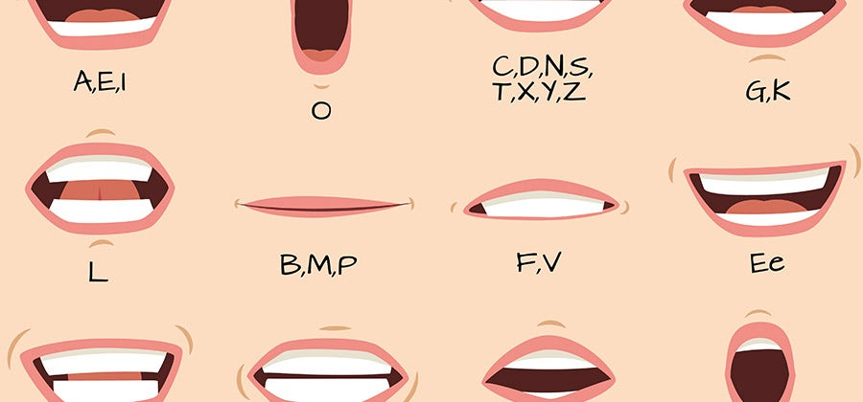
Two Major Types of Deepfakes
1. Face Swapping (Body Replacement)
• Puts one person’s face onto another person’s body • The body is real, the face is fake • Used in movies — and sometimes misused
2. Voice / Speech Synthesis (Lip Syncing)
• Makes someone look like they said something they didn’t • AI moves the mouth to match a fake audio track
AI matches sounds → mouth shapes → realistic lip syncing.
Notes:
Now let’s look at the two most common types of deepfakes you’ll see online.
1. Face Swapping — Body Replacement
“The first type is face swapping. This is when AI takes one person’s face and puts it onto someone else’s body.”
“The body is real, but the face you see is fake.”
“Movies use this for stunts — but sometimes it’s misused online.”
“Deepfake celebrity videos often use this technique.”
2. Voice / Speech Synthesis — Lip Syncing
“The second type makes someone appear to say something they never said.”
“AI can generate a fake voice that sounds real.”
“Then it matches the mouth movements to that fake audio.”
“So the video looks natural, even though the words are fake.”
“These two techniques together can create extremely realistic fake videos. That’s why learning how to spot them is so important.”

Slide 43
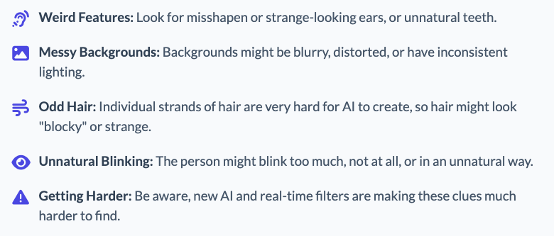
Activity: Which Face Is Real?
"Which Face Is Real?" Game
https://www.whichfaceisreal.com/
(Don’t click on ads on the website.)
(Some images may look strange or funny—this is normal. If something feels uncomfortable, look away and tell your instructor.)
What to Look For: Clues to Spot a Fake
Notes:
Alright everyone, time for a really fun challenge!
We’re going to play a quick game called ‘Which Face Is Real?’ The website shows you two faces — one is a real person, and one was completely created by AI.
Your job is to guess: Which face is real?
Before we start, here are a few safety reminders:
Don’t click on any ads on the website.
If any picture looks weird or makes you uncomfortable, look away and tell me right away. Some AI faces can look strange — that’s normal.
Now, here are clues to help you spot AI fakes:
Weird features: Look for strange ears, crooked or unrealistic teeth.
Messy backgrounds: AI often struggles with the background — it might look blurry or warped.
Odd hair: AI can’t create individual hairs well, so the hair might look too smooth or ‘blocky’.
Unnatural blinking: Sometimes the person doesn’t blink, blinks too often, or blinks incorrectly.
And finally… AI keeps getting better, so some fakes are harder to spot!
Ready? Let’s test your detective skills!

Slide 44
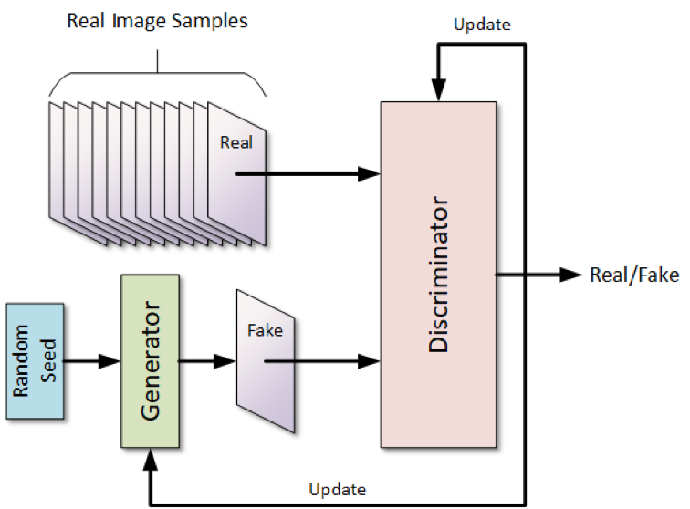
How Are They Made? The Tech: GANs
Deepfakes are made using a “GAN” (a special kind of AI with two parts competing)
A GAN has two AIs playing a game:
1. The Generator – Tries to create a fake image – Tries to fool the other AI
2. The Discriminator – Tries to spot which images are fake – Trains itself to catch the Generator
🎮 It’s like two players leveling up by battling each other — the faker vs the detector.
Two AIs play a fake-vs-real game. Both get better over time.
Notes:
Alright everyone, now let’s look behind the scenes and learn how deepfakes are actually created. The technology that powers most deepfakes is something called a GAN — a Generative Adversarial Network. That sounds complicated, but don’t worry — it’s actually a simple idea.
A GAN is basically two AIs playing a game against each other.
1. The Generator — the Faker
Think of the Generator as the AI artist.
It tries to create a fake image… like a fake face.
Its goal is to fool the other AI into thinking the fake is real.
So it keeps trying, failing, and improving.
2. The Discriminator — the Detective
This is the AI inspector.
It looks at images and tries to spot the fake ones.
Every time it catches the Generator, it learns too.
Every time it gets fooled, it also learns.
🎮 A Game of AI vs AI
The Generator → tries to fool the Discriminator. The Discriminator → tries to catch the Generator.
Every round, both get better.
This is why deepfakes today look more and more realistic — the AIs have trained each other by competing thousands of times.
(Diagram)
“So this picture shows the process: Real images go to the Discriminator… The Generator produces fake images… And the Discriminator gives feedback. Both AIs keep improving through this back-and-forth battle.”

Slide 45
The Impact of Deepfakes
This technology has both positive and negative implications for society.
Examples of positive impacts:
Making old actors look young in movies
Re-creating historical events
Examples of negative impacts:
Fake political videos
Fake celebrity content
Scam videos
Notes:
Now that we know how deepfakes work, let’s talk about why this technology matters.
Deepfakes can be good or bad, depending on how people use them.
⭐ Positive Impacts
Deepfake technology can actually help in creative industries:
Movies: Studios can make older actors look young again, or bring back characters from the past. Think of it like digital makeup that looks super realistic.
History: Deepfakes can help us re-create historical events, making them easier to visualize and understand—kind of like bringing history to life.
⚠️ Negative Impacts
But deepfakes can also be misused, and this is where the risks come in:
Fake political videos: Someone could make a politician appear to say something they never said. This can be dangerous because people may believe it.
Fake celebrity content: You may have seen videos of celebrities doing things that look totally real—but they're not. Many of these are deepfakes.
Scams: Deepfake videos and voices can trick people into sending money or believing false information.
💬 Summary
So, just like many tools in technology, deepfakes have amazing creative uses, but also serious risks. Our goal today is to learn how to spot fake content, so we can protect ourselves and others.”

Slide 46
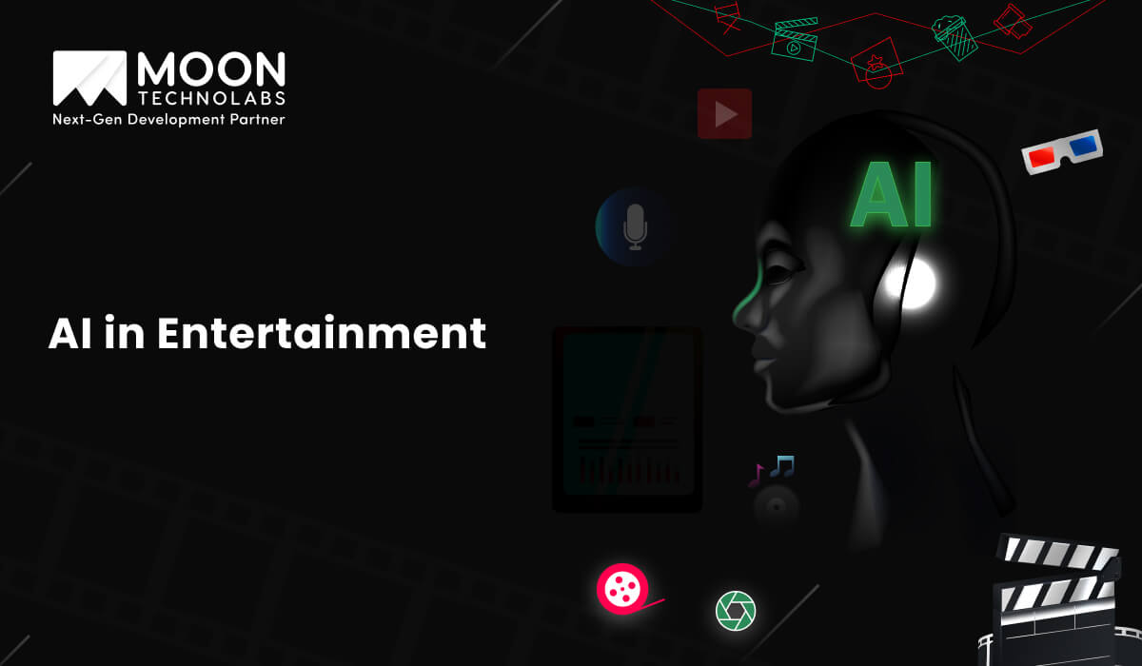
Potential for Good
Movies & Entertainment: Used for special effects, like making actors look younger, or bringing historical figures to life.
Education: Creating interactive historical recreations or advanced simulations for training.
Art & Creativity: Allowing artists to create new forms of digital expression.
Accessibility: Synthesizing voices for people who have lost their own.
Notes:
Let’s look at the good side — because AI deepfake technology isn’t all bad. It actually has some amazing positive uses when used responsibly.
⭐ Movies & Entertainment
Deepfake-style tech is used in Hollywood all the time. It helps make actors look younger, bring historical characters back to life, or create special effects that would normally cost millions of dollars. So if you’ve seen a movie where someone looks magically younger… this technology is probably involved!
⭐ Education
Imagine learning history by actually seeing famous people come to life — Abe Lincoln speaking, or ancient civilizations animated. Deepfake-style tools help create interactive lessons and realistic training simulations.
⭐ Art & Creativity
Artists can create brand new forms of digital expression — mixing styles, voices, faces, and visual effects that weren’t possible before. It gives creative people a whole new set of tools.
⭐ Accessibility
One of the most meaningful uses: AI can create voices for people who have lost their ability to speak. Someone who can’t talk can still communicate using an AI-generated version of their natural voice — that’s incredibly powerful.
So yes, deepfakes can be misused, but there are also truly helpful and inspiring applications that make people’s lives better.”

Slide 47
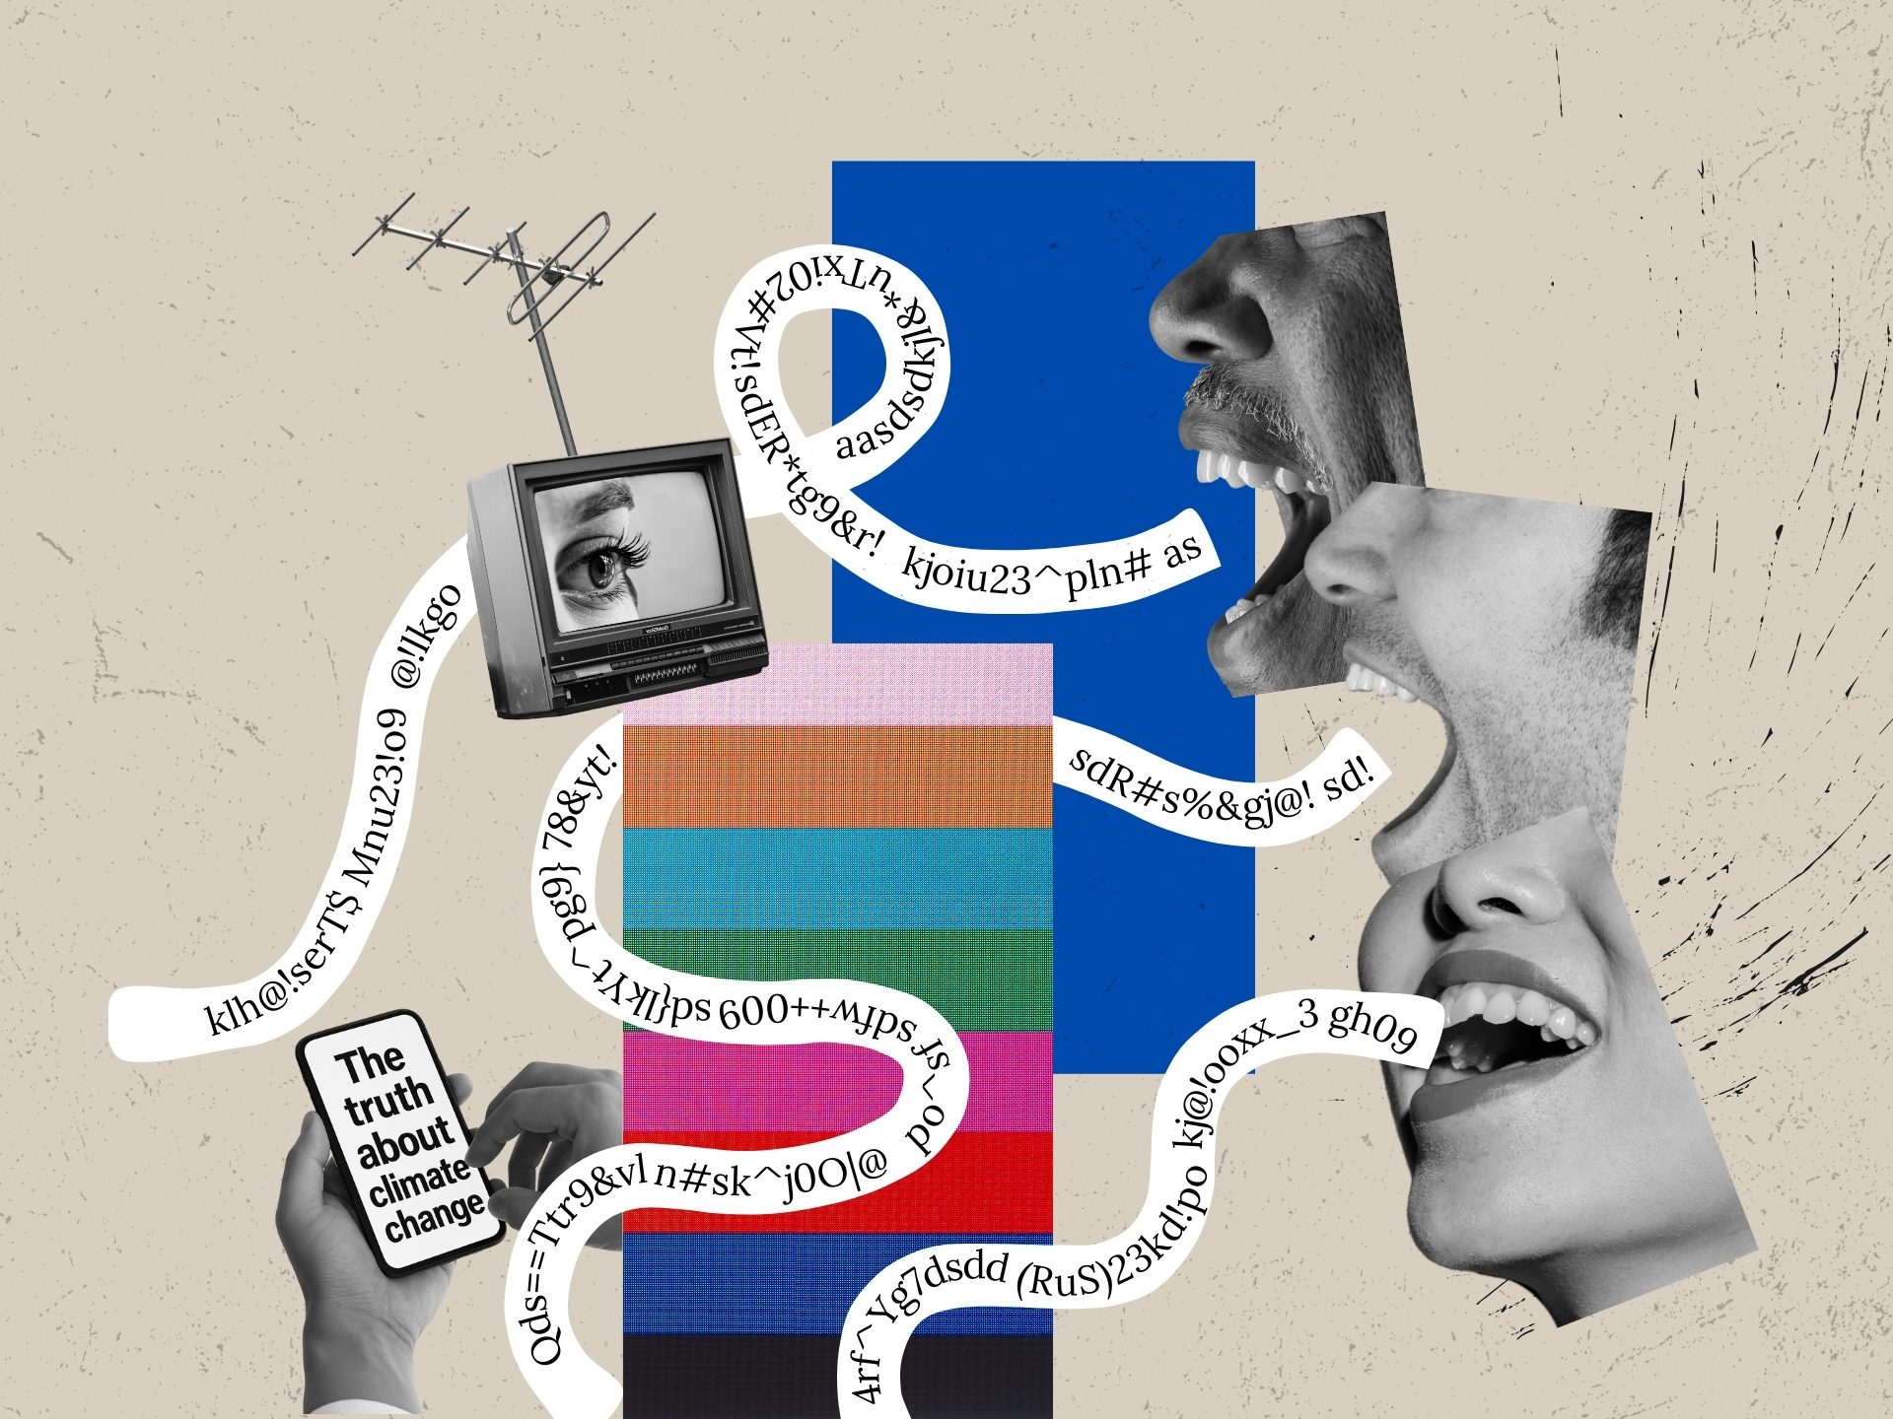
Risks and Dangers
Misinformation: Creating fake videos of politicians or leaders to spread "fake news."
Fraud & Scams: Impersonating someone to ask for money or steal an identity.
Hurting or embarrassing people online: Falsely placing people in images or videos without their consent.
Tricking people to change their beliefs: Spreading propaganda or influencing public opinion.
Notes:
Alright everyone, now that we’ve learned how deepfakes work and how amazing the technology can be… we also need to talk about the other side — the risks.
Deepfakes are powerful, but that also means they can be misused if people aren’t careful or responsible.
Let’s look at some of the biggest dangers:
First, misinformation. People can use deepfakes to create fake videos of politicians, celebrities, or leaders saying things they never said. These videos can spread very quickly online and confuse people. This is one reason we see so much ‘fake news.’
Second, fraud and scams. Someone could make a deepfake of a friend or family member asking for money… or even pretend to be your boss! This is why we always double-check before trusting messages or videos.
Third, hurting or embarrassing people. Deepfakes can put someone’s face into a video without their permission. Even if it’s meant as a joke, it can still hurt or embarrass people, especially kids and teenagers.
And finally, influencing beliefs. Deepfakes can be used to trick people, spread propaganda, or change public opinion. If we don’t know what’s real and what’s fake, it becomes harder to make good decisions.
So the big message is this: Deepfake technology is powerful — and that means we need to be smart, cautious, and responsible when we see videos online.”

Slide 48
Why Is It So Hard to Tell?
📚 Massive Training Data
The AI models are trained on millions (or billions) of real faces and videos from the internet. They learn the tiniest details of human features, lighting, and texture.
For example: AI learns small details like eyebrows, shadows, reflections.
⚔️ Constant Improvement
The "adversarial" process means the AI is always in a competition with itself to get better. The "Generator" and "Discriminator" keep improving, making the fakes more realistic every day.
Notes:
“Now we’re going to talk about why deepfakes are getting so difficult to detect — even for adults, experts, and sometimes even AI tools.
There are two big reasons.
📚 1. Massive Training Data
“First, AI has been trained on millions or even billions of real photos and videos of actual people. So it learns tiny details — things like:
eyebrows
skin texture
lighting and shadows
reflections in the eyes
Because AI has seen so many examples, it becomes very good at copying all those details and recreating them in a fake image. This is why deepfakes can sometimes look super realistic.”
⚔️ 2. Constant Improvement
“Second, deepfake technology improves every single day.
Deepfakes are created using something called an adversarial process. That means two AIs are basically playing a game:
One AI (the Generator) makes fake images
The other AI (the Discriminator) tries to catch the fake
Every time the Discriminator catches the fake, the Generator improves. And every time the Generator gets better, the Discriminator improves too.
So they’re constantly leveling up — just like two players practicing against each other.”
Summary
“That’s why deepfakes today are harder to spot than ever before. The AI has tons of training data, and it gets better every day through competition.”

Slide 49
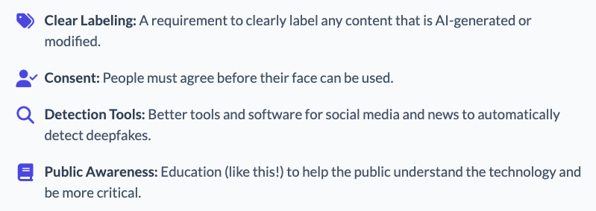
What Can We Do? Safeguards We Need
Notes:
“Now that we’ve seen the good and the bad of deepfakes, let’s talk about what we, as a society and as individuals, can actually do about it.
There are four big safeguards that experts recommend:
🔖 1. Clear Labeling
This means anything that is AI-generated — whether it’s an image, video, or audio — must be clearly labeled. If it's edited, if it's synthetic, people should know. This helps prevent confusion and misinformation.
🙋 2. Consent
Your face belongs to you. Before anyone uses your image or likeness in an AI-generated video, they must get your permission. This is especially important for kids and teens who might not realize how easily their photos can be misused.
🔍 3. Detection Tools
Social media and news platforms need stronger tools to automatically detect deepfakes. Just like spam filters catch junk email, AI tools can catch fake videos — but they need to get better.
📚 4. Public Awareness
That’s exactly what we’re doing right now — learning how the technology works so we can spot the signs and make smarter decisions online. The more people understand deepfakes, the harder it becomes for bad actors to misuse them.
So the goal isn’t to fear the technology — it’s to understand it and use the right safeguards to stay safe.”

Slide 50
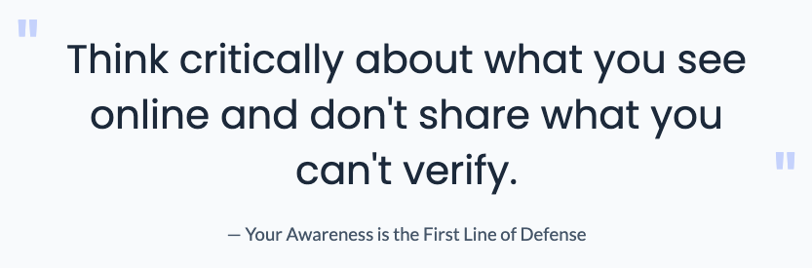
Be Part of the Solution
Being careful online is your superpower!
Notes:
Before we wrap up, here’s the most important message of this whole section:
Think critically about what you see online, and don’t share things unless you’re sure they’re real.
AI is powerful — and deepfakes are getting better every day — but your awareness is still the strongest defense.
If something feels strange, confusing, or too shocking… pause, double-check, and don’t share it right away.
Being careful online is honestly your superpower. You can help stop misinformation just by thinking for a few seconds before you click ‘share.’”

Slide 51
Key Takeaways
Deepfakes are AI-generated fake images or videos that look real
Two AIs work together in a game: one makes fakes, one tries to catch them
Deepfakes can be used for good (movies, art, accessibility)
Deepfakes can also be harmful (misinformation, scams, harassment)
It’s becoming harder to tell real from fake
We should always think before sharing anything online

Slide 52
AI for Good
Use AI to help people, help communities, and help the planet.

Slide 53
AI for Good
AI for Good means using AI to help people, help communities, and help the planet.
❤️ Health & Safety
🌍 Environment
♿ Accessibility
🎓 Education & Learning
Notes:
Now we’re entering one of my favorite sections — AI for Good.
Not everything about AI is scary or dangerous. In fact, some of the most important uses of AI are about saving lives, protecting the environment, and helping people.
This section will show how AI can actually make the world better.”

Slide 54
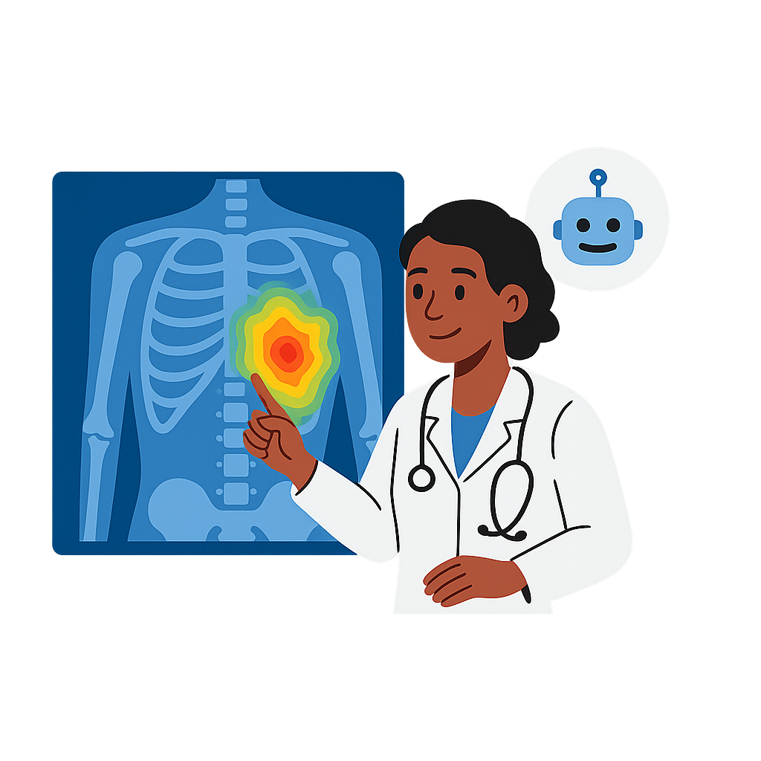

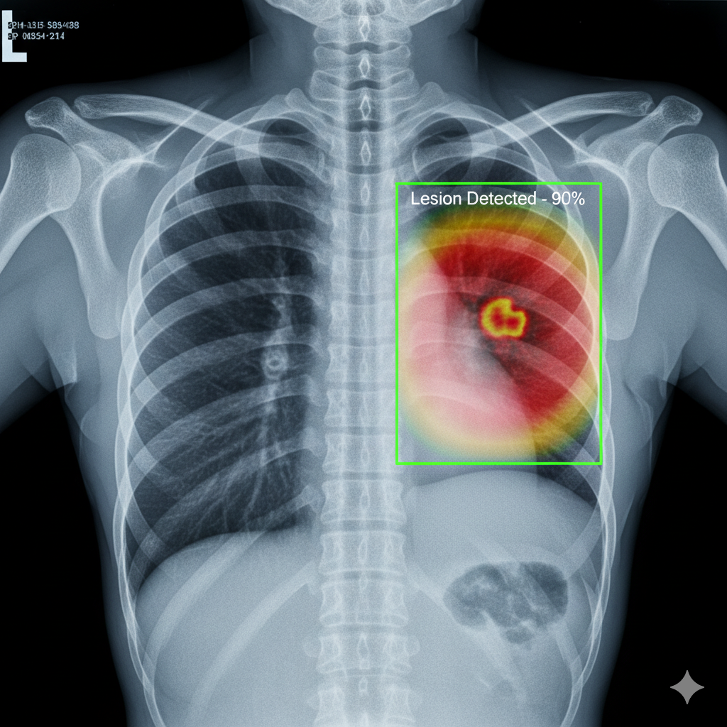
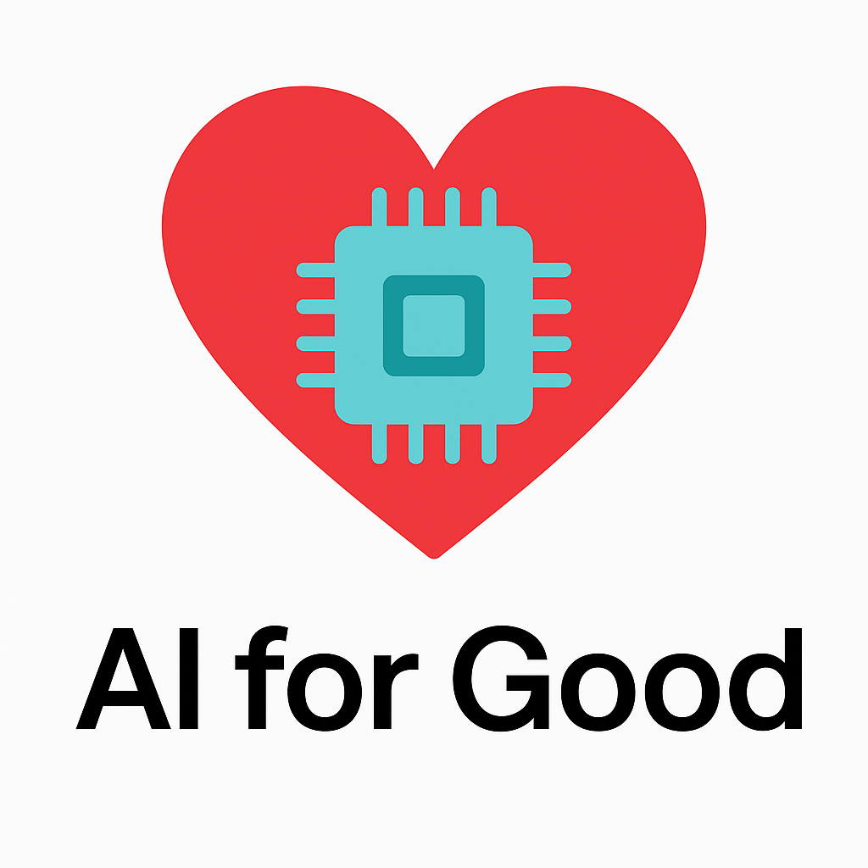
❤️ AI for Health — Saving Lives
AI detects early signs of cancer in X-rays and MRIs
AI helps doctors read scans faster
Smartwatches use AI to detect irregular heartbeats
AI helps doctors find patterns in X-rays that are hard for humans to see.
Videos:
AI helping doctors spot cancer early
AI technology could help detect cancer early
Normal Scan
AI-detected Lesion
Notes:
Let’s start with health. AI is becoming like a super-strong assistant for doctors.
AI can look at X-rays and MRIs and spot early signs of cancer — sometimes earlier than humans can.
Doctors use AI to read scans faster, especially when hospitals are busy.
And devices like Apple Watches use AI to detect irregular heartbeats and warn you before something goes wrong.
Look at the two images on the slide. On the left is a normal chest X-ray. On the right, the AI highlights something suspicious — this helps doctors catch problems early.
AI doesn’t replace doctors — it helps them do more, faster, and more accurately.
“Do you know someone who wears an Apple Watch or Fitbit? What does it detect?”

Slide 55

🚦AI for Safety — Helping Us Make Better Decisions
Examples:
Cars use AI for lane detection, blind spot alerts, emergency braking
Phones detect car crashes and call 911
Smart home devices detect fire/smoke earlier
Question:
Would you trust a car that can help you brake before you hit something?
https://www.youtube.com/shorts/4mnYdOxhjjY
https://www.youtube.com/shorts/P4E515bd2QM
Notes:
AI can also keep us safe. Many cars today use AI to watch the road. They can detect the lane, warn about cars in your blind spot, and even brake automatically to avoid a crash.
Your phone also uses AI — for example, it can detect a car crash and automatically call 911.
Smart home devices use AI to detect fire or smoke earlier, so people can get help faster.
Here is an example. The AI in the car sees danger ahead and shows a warning sign.
Let me ask you a question: Would you trust a car that can help you brake before you hit something?

Slide 56
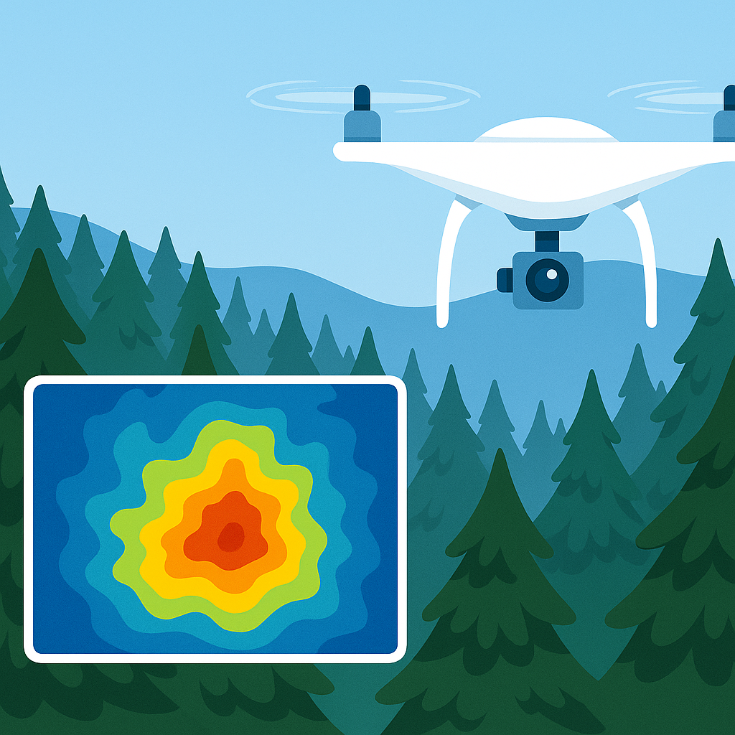
🌳 AI for the Environment — Protecting Our Planet
Examples:
AI monitors forests to detect wildfires early (satellite + heat AI)
AI tracks endangered animals
AI predicts storms, floods, extreme weather
Drones + AI help plant trees faster
Question:
Which problem do YOU think AI should fix first — wildfire, pollution, or animals disappearing?
Videos:
Firefighters vs. AI: Who Spots Wildfires Faster?
Google AI wildfire detection project
Notes:
AI can also help protect our planet. It can watch forests from the sky to detect wildfires early. It can track animals that are endangered so scientists know where they are. AI can also predict storms and floods before they happen. And drones using AI can help plant trees much faster.
Here is an example: A drone flies over a forest and shows a thermal heatmap. This can help spot fires or find animals even when they’re hard to see.
Which problem do YOU think AI should fix first — wildfires, pollution, or animals disappearing?

Slide 57
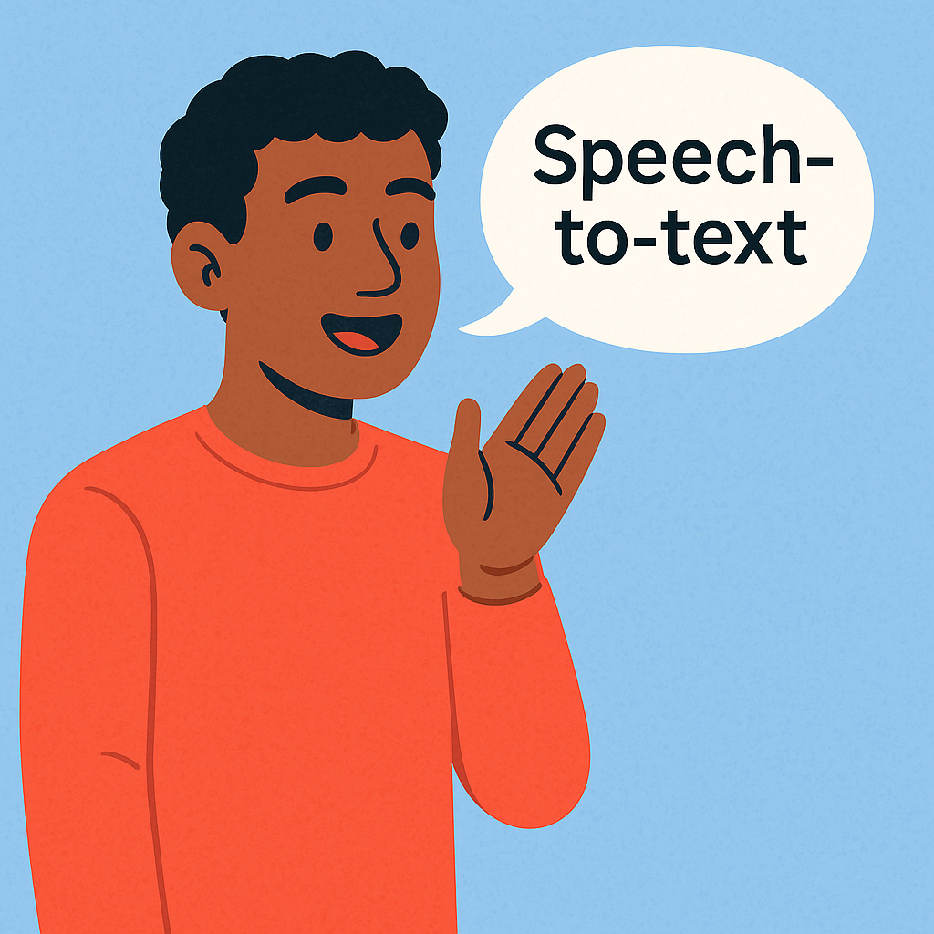
♿ AI for Accessibility — Helping Everyone
Examples:
Auto-captioning on TikTok / YouTube
Voice-to-text for people who can’t type
AI apps for the visually impaired (“Lookout”, “Seeing AI”)
Live speech captioning on Google Meet / Zoom
AI turns spoken words into text instantly.
Notes:
AI also helps people who need extra support. For example, TikTok and YouTube can create captions automatically. Phones can turn your voice into text if you can’t type. And apps like Lookout and Seeing AI can read text out loud or describe what’s around you.
This picture shows speech turning into text — something we use every day.

Slide 58
🎓 AI for Learning — Helping Students
Examples:
AI tutors like ChatGPT
AI that reads PDFs out loud
AI that explains problems step-by-step
AI translation tools to help non-native speakers (like you!)
“I also use AI to help improve my English.”
Notes:
“Now let’s look at how AI can help YOU learn.
AI isn’t just for big science labs — it’s something students everywhere use every day, sometimes without even realizing it!
⭐ Examples:
• AI tutors like ChatGPT These can answer questions, explain homework, and give examples to help you understand faster.
• AI that reads PDFs out loud If a long article is hard to read, AI can speak it for you so you can listen instead.
• AI that explains problems step-by-step Math, science, history — AI can break information into clear steps so it becomes easy to follow.
• AI translation tools These help students who speak different languages understand English better… (and help English speakers understand other languages too!)
I actually use AI myself — even I use AI tools to help improve my English and learn new things every day!
AI doesn’t replace teachers. But it can be a helpful learning buddy that makes studying faster, easier, and more fun.”

Slide 59
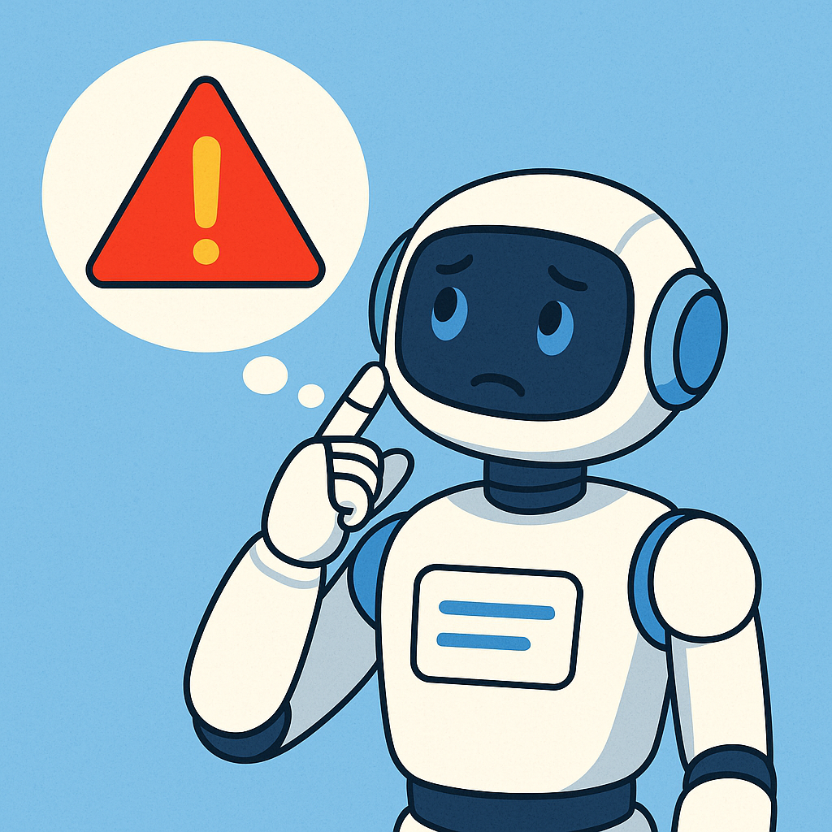
AI Helps — But Humans Decide
AI is smart, but not perfect
AI can make mistakes
AI doesn’t understand feelings
People must check and decide the final answer
AI can help… but humans must stay in control.”
Notes:
AI is very smart, but it’s not perfect.
AI can still make mistakes or misunderstand things.
Also, AI doesn’t understand feelings or emotions.
So even when AI helps us, humans should always check the result and make the final decision.
AI helps… but people are still in charge.

Slide 60
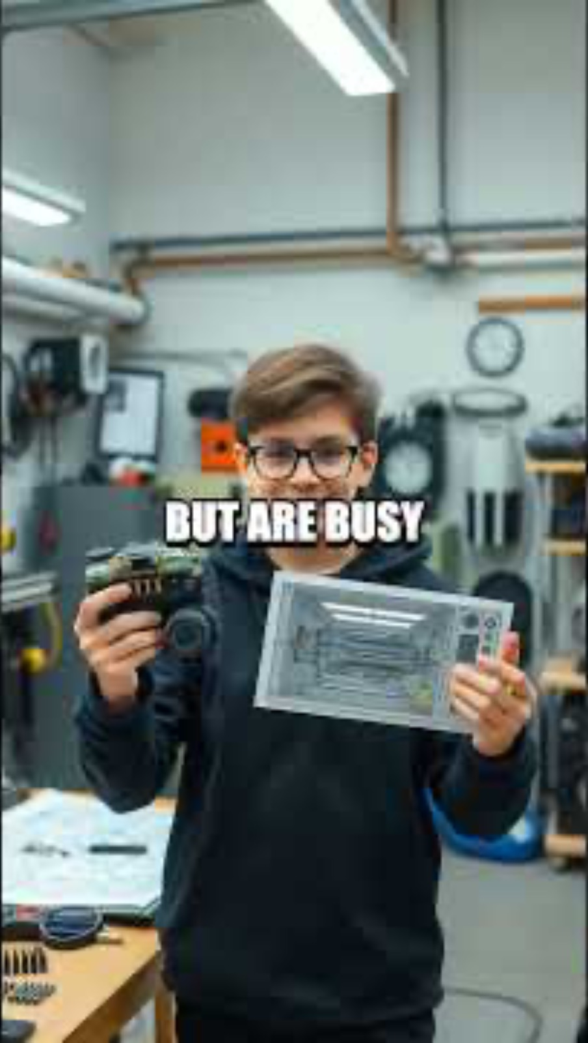
🔥 Teens Building AI Inventions
Notes:
One of the coolest things about AI today is that kids and teens—just like you—are inventing with it.
There are teens building:
• AI robots • AI apps • AI science projects • AI solutions for their schools and communities
YOU don’t need to wait to be an adult to start building with AI.
All you need is curiosity and a problem you want to solve.
And sometimes… well… teens are building awesome stuff but are very busy doing it!

Slide 61
Group Activity - AI for Good Brainstorm
Prompt: “If you had unlimited AI power, what problem would you fix?”
Categories:
School life
Environment
Community
Health
Fun / daily life
Examples:
“AI that reduces homework stress”
“AI that cleans the ocean”
“AI that stops wildfires”
“AI friend for lonely people”
Take 1 minute to think silently. Then share with the group!
Notes:
Now it’s your turn to think big! If you had unlimited AI power — and anything was possible — what problem would YOU fix in the world?
You can choose from school life, environment, community, health, or just fun ideas for daily life.
Take one minute to think. Then we’ll share a few ideas together.”

Slide 62
Q & A

